Slide 1







© MobiCom 2025
Hong Kong, China
WDNN: Weighted Diffractive Neural Network for Physical-layer RF Signal Processing
Yezhou Wang, Yongjian Fu, Hao Pan, Qinyun Hu,
Lili Qiu, Yi-Chao Chen, Guangtao Xue, Ju Ren
Notes:
Thank you so much for the introduction. Good afternoon, everyone! My name is Yezhou Wang, and I'm from Shanghai Jiao Tong University. Today, I’m excited to share our work called "WDNN: Weighted Diffractive Neural Network for Physical-layer RF Signal Processing." In this research, we’re looking at how to achieve efficient neural network-based signal processing at the physical layer.
感谢主持人的介绍。大家好，我是来自上海交通大学的王叶舟。今天很高兴有机会向大家汇报我们的工作，题目是《WDNN: Weighted Diffractive Neural Network for Physical-layer RF Signal Processing》。我们的研究主要聚焦于在物理层实现高效的神经网络信号处理，尤其针对射频信号处理任务，提出了一种全新的加权衍射神经网络架构——WDNN。

Slide 2
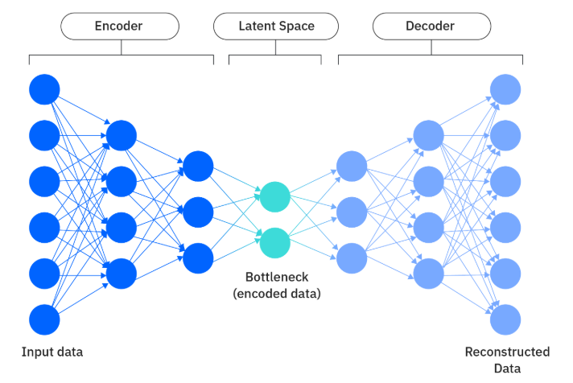
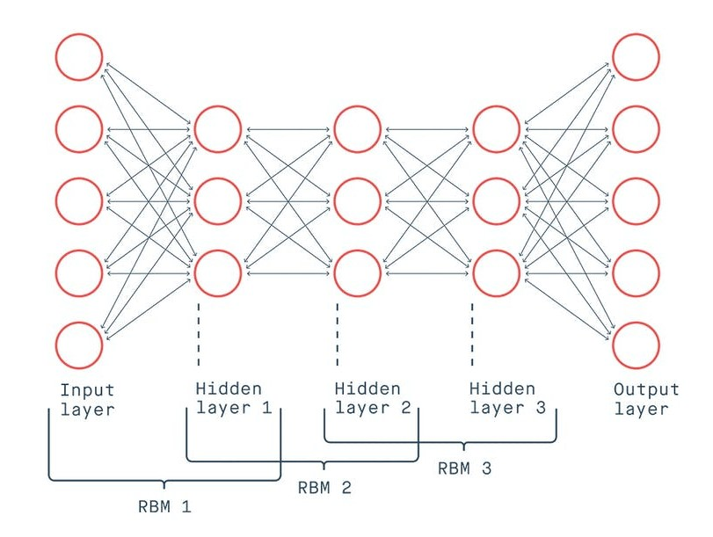
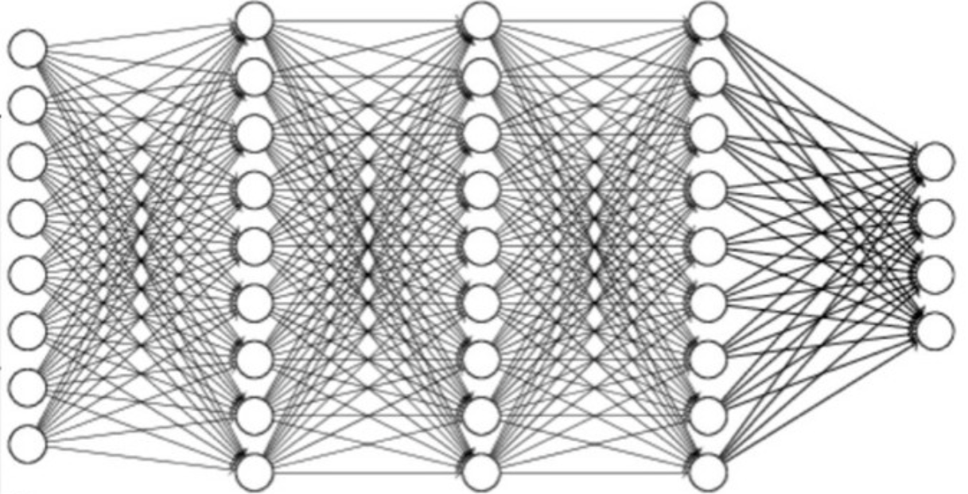











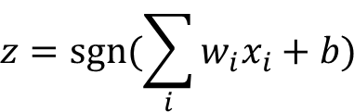
Neural Network and Neuronal Computation
Neural Network
Neuron and Neuronal Computation
$$1$$
$$x_{1}$$
$$w_{1}$$
$$b$$
Input
layer
Output
layer
$$x_{2}$$
$$y$$
$$z$$
$$w_{2}$$
$$∑$$
sgn
$$w_{3}$$
$$x_{3}$$
$$z=sgn⁡(\sum_{i}{w_{i}x_{i}}+b)$$
…
Hidden layers
Deep Neural Network (DNN)
Variational AutoEncoder (VAE)
Deep Belief Network (DBN)
Notes:
First, let’s briefly review the basic structure of neural networks. Basically, you have an input layer, a few hidden layers in the middle, and an output layer at the end. Each layer changes its input using weights and biases, and then adds some nonlinearity with activation functions like Sigmoid or ReLU.
【click】 Some popular types—like DNN, VAE, and DBN—use these same ideas to help them learn complicated patterns and features.
But here’s the catch: Most neural networks run on digital computers, which actually use a lot of power and can be pretty slow. So, when we need real-time results and energy efficiency, for example in edge computing or IoT devices, it’s tough for traditional digital platforms to keep up.
首先，我们来回顾一下传统神经网络的基本结构。神经网络通常由输入层、隐藏层和输出层组成。每一层通过权重（W）和偏置（b）对输入进行线性变换，并利用非线性激活函数（如 Sigmoid 和 ReLU）赋予网络非线性表达能力。
【click】常见的结构如深度神经网络（DNN）、变分自编码器（VAE）、深度置信网络（DBN）等，都是通过上述机制，实现了复杂的函数拟合和特征提取。
然而，这些神经网络大多运行在数字计算平台上，存在着功耗高、延迟大的问题。特别是在边缘计算和物联网（IoT）等场景下，难以满足对实时性和能效的要求。

Slide 3
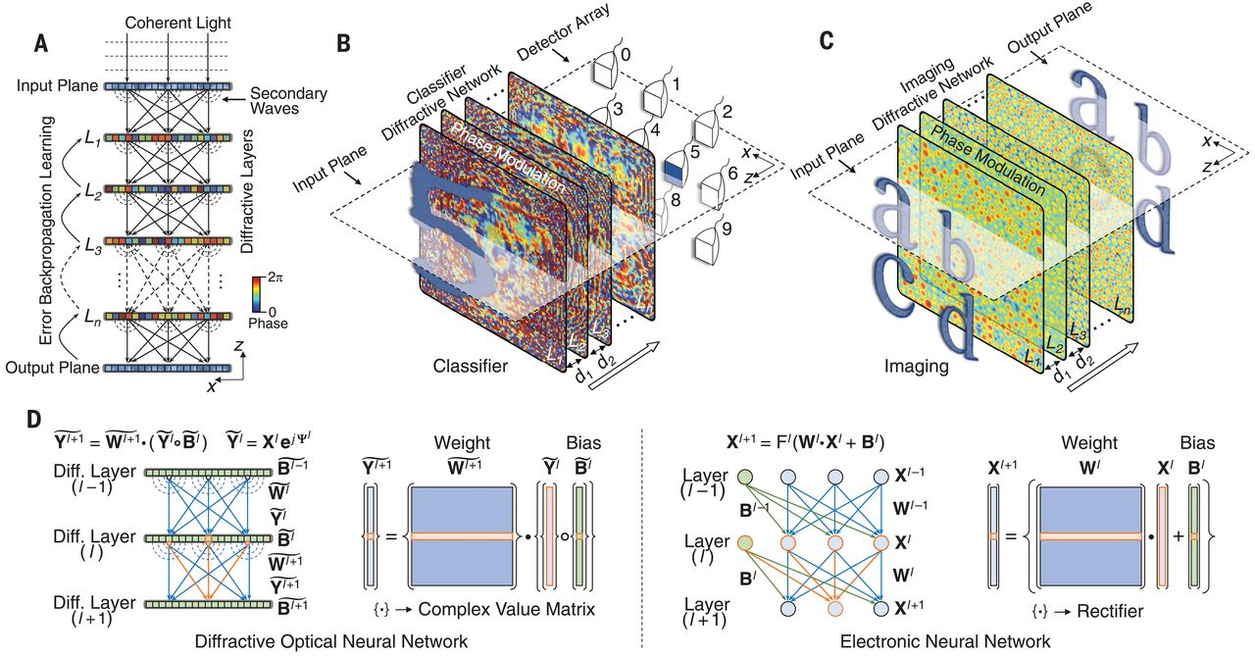
Diffractive Neural Network
[1] All-optical machine learning using diffractive deep neural networks. Science 2018.
Notes:
To tackle these challenges, researchers have recently come up with Diffractive Neural Networks. These are all-optical networks, meaning they use light—rather than electricity—to do their calculations. Basically, they perform matrix operations using light diffraction, so there’s no need for traditional electronic computation.
为了解决上述问题，近年来衍射神经网络（Diffractive Neural Network, DNN）应运而生。它是一种全光学的神经网络，通过光的衍射传播实现矩阵运算，无需依赖电子计算。
如图所示，输入的光信号通过多层超表面（metasurface）进行衍射，每一层对应于神经网络的一个层级。光的相位和幅度在这里分别起到类似权重和偏置的作用，最终在输出平面上形成分类结果。
这一方法不仅拥有超低的能耗和极高的并行性，还为物理层AI的发展提供了重要方向。

Slide 4
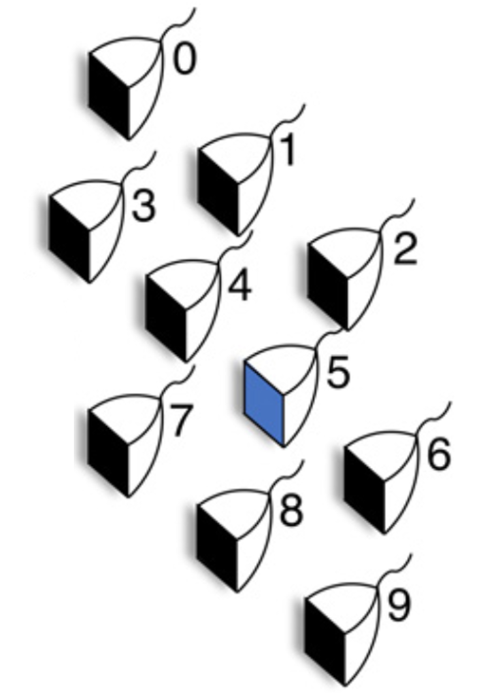
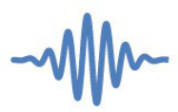

















Metasurface-based Diffractive Neural Network
$$1$$
$$x_{1}$$
$$w_{1}$$
$$b$$
Input
layer
Output
layer
$$x_{2}$$
$$w_{2}$$
$$y$$
$$z$$
$$∑$$
sgn
$$x_{3}$$
$$w_{3}$$
…
$$z=sgn⁡(\sum_{i}{w_{i}x_{i}}+b)$$
Hidden layers
(Propagation zones)
Meta-atom
Diffracted waves
Detector array
(i.e., antenna)
Diffraction zones
…
…
…
$$w_{1}$$
Incident signals
Incident
waves
Secondary
wave
$$w_{2}$$
$$w_{3}$$
$$b$$
Meta-atom
…
Multi-layer
metasurface
Excitation
wave
Input
layer
Diffractive layers
Output
layer
Meta-atom
Notes:
In optical diffractive neural networks that use metasurfaces, the setup is built from several diffraction zones, and each layer is made up of lots of tiny structures called meta-atoms.
【click】 When an electromagnetic wave hits each meta-atom, it changes the phase and amplitude of the wave, creating new waves that move on to the next layer.
【click】 This process is kind of like the way neurons and fully connected layers work in traditional digital neural networks.
在基于超表面的光学衍射神经网络中，其结构由多层神经网络构成diffraction zones，每层超表面由meta-atom组成。
入射的激励电子波传播到每个meta-atom后，每个meta-atom能够对入射波的相位与幅度进行修改，产生secondary wave，传播到下一层。
这样的操作类似与神经网络中的神经元和全连接层。

Slide 5
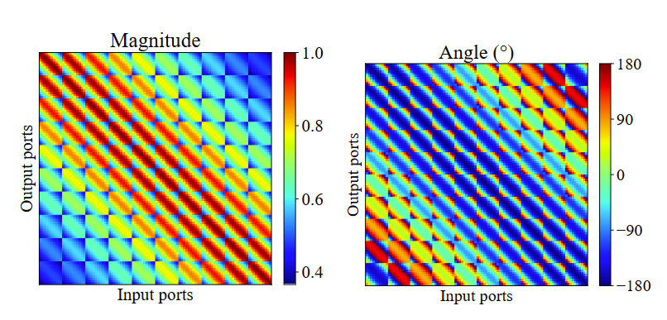




Propagation Weights of the Metasurface-based Diffractive NN
Meta-atom
Diffracted waves
Detector array
(i.e., antenna)
Multi-layer
metasurface
…
…
…
$$w_{1}$$
Incident signals
Incident
waves
$$w_{2}$$
$$w_{3}$$
$$b$$
…
Input
layer
Diffractive layers
Output
layer
Propagation weight matrix
Diffraction Zones
Propagation weight matrix (complex value):
Amplitude between two units
Phase delay between two units
Distance of two units DETERMINE the weights
- Limited adjustment space
Notes:
Each meta-atom acts like a neuron, adjusting the amplitude and phase of the incoming signal.
【click】 In diffractive neural networks, the way light moves between layers is similar to complex matrix multiplication. Each meta-atom is connected to every meta-atom in the next layer through the air gaps, just like a fully connected layer in a digital network. The "weights" of these connections depend on how much the signal is changed—both in amplitude and phase—as it travels.
【click】 Here’s a visualization showing how each transmission matrix changes amplitude and phase during light propagation.
【click】 But, since the transmission matrix is set by the physical distance between layers, there isn’t much room to tweak or optimize the network. This limits how flexible and powerful the network can be.
每个超原子（meta-atom）相当于一个神经元，上一层的每个超原子，通过空气间隙的传播作用，被连接到下一层的每个超原子，形成类似于全连接层的结构。神经元之间的连接权重由传播距离导致的幅度衰减和相位延迟来决定。
【click】在衍射神经网络中，每一层的信号传播过程可以看作是一个复值矩阵乘法，能够对每个输入施加幅度衰减和相位延迟的偏置。
【click】以 MNIST 数据集为例，所有连接权重共同组成了传输权重矩阵，多层超表面的叠加则构成了完整的神经网络。入射波经过多层神经网络传播后，到达最后一层的探测器阵列，其中强度最高的神经元直接输出识别结果。
【click】右侧展示的是每一次传播矩阵对信号幅值和相位调整的可视化结果。
【click】然而，由于超表面之间的传输矩阵由空气间隙决定，这种实现方式存在调整空间有限的问题，难以灵活优化网络结构和性能。

Slide 6
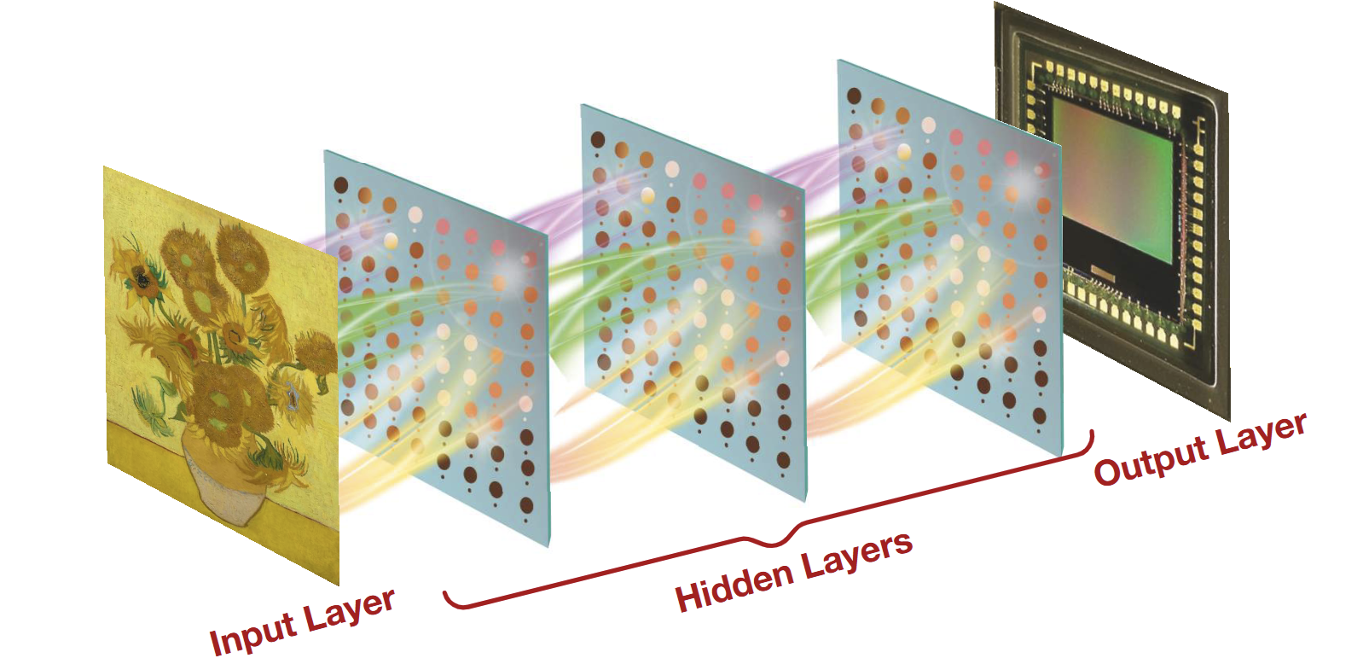
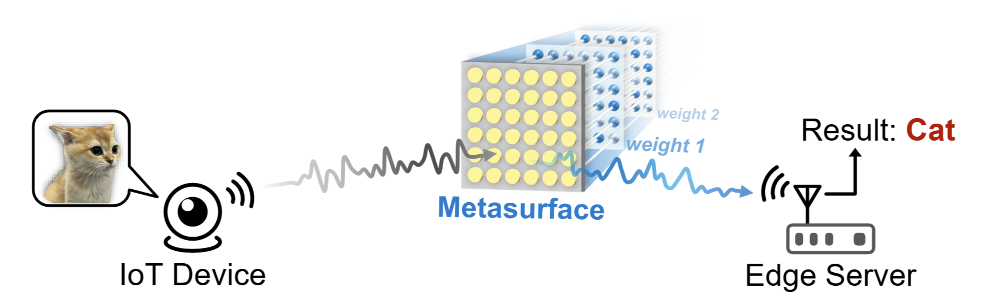
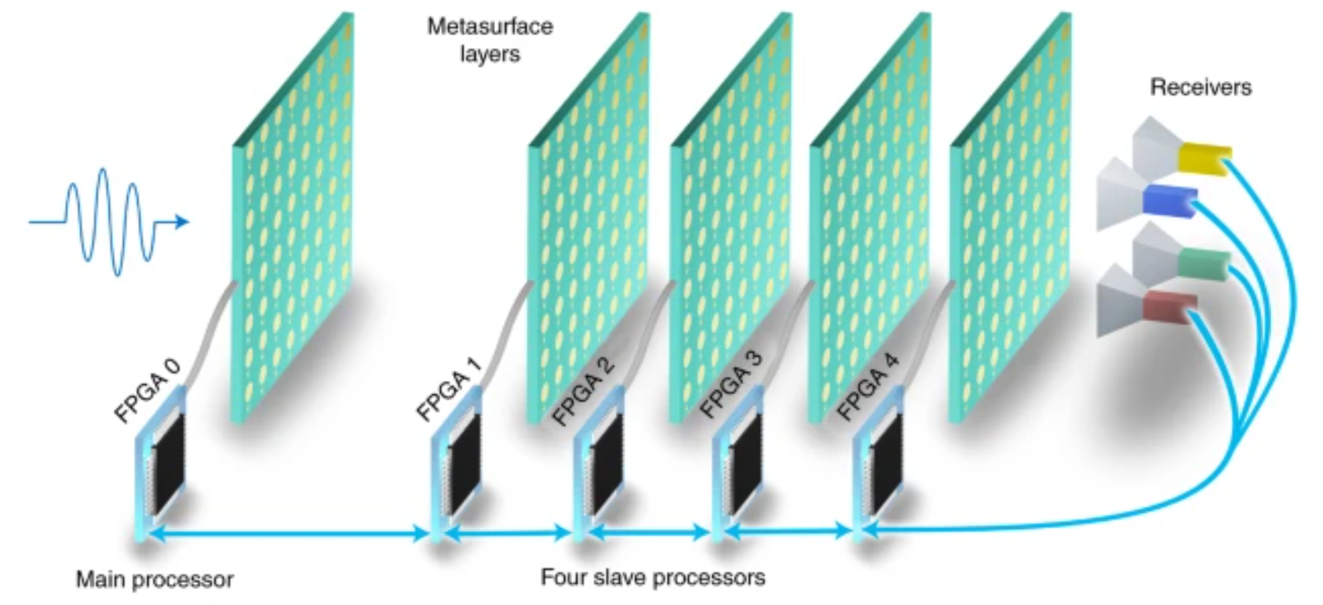
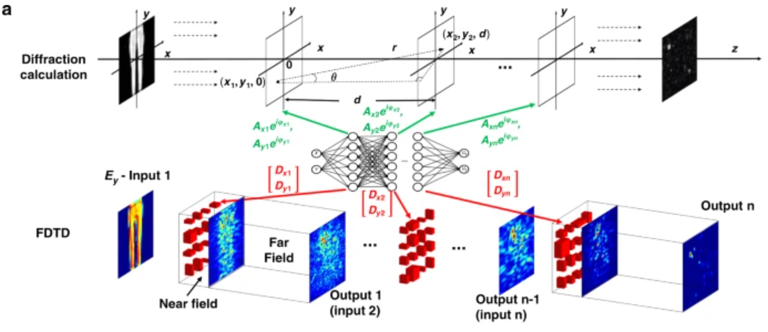
Existing Works Based on Physical Diffractive NN
[1] Binary Optical Machine Learning: Million-Scale Physical Neural Networks with Nano Neurons. ACM MobiCom 2024.
[2] Enabling Over-the-Air AI for Edge Computing via Metasurface-Driven Physical Neural Networks. ACM SIGCOMM 2025.
[3] A programmable diffractive deep neural network based on a digital-coding metasurface array. Nature Electronics 2022.
[4] Metasurface-enabled on-chip multiplexed diffractive neural networks in the visible. Nature light: science & applications 2022.
Notes:
Right now, there are several related works to build diffractive neural networks with metasurfaces.
For example, some researchers have made optical neural networks with millions of neurons using nanoscale metasurfaces.
Others use programmable metasurfaces for airborne AI.
There are also diffractive networks with real-time tuning for image recognition.
And some designs work completely on-chip with visible light, handling multiple tasks all in one chip.
目前，已经有多种基于超表面和射频（RF）电路的衍射神经网络实现方案。例如：
• [1] 利用纳米级超表面，实现了百万级神经元规模的光学神经网络；
• [2] 采用可编程超表面阵列，完成了空中AI推理；
• [3] 在可见光波段，实现了片上多路复用的衍射神经网络；
• [4] 运用太赫兹波段的仿等离激元（spoof plasmonic）结构进行信息识别。
尽管这些方案在特定应用场景下取得了良好的效果，但它们普遍存在权重调整受限、缺乏复值偏置、以及缺乏非线性激活等问题。

Slide 7
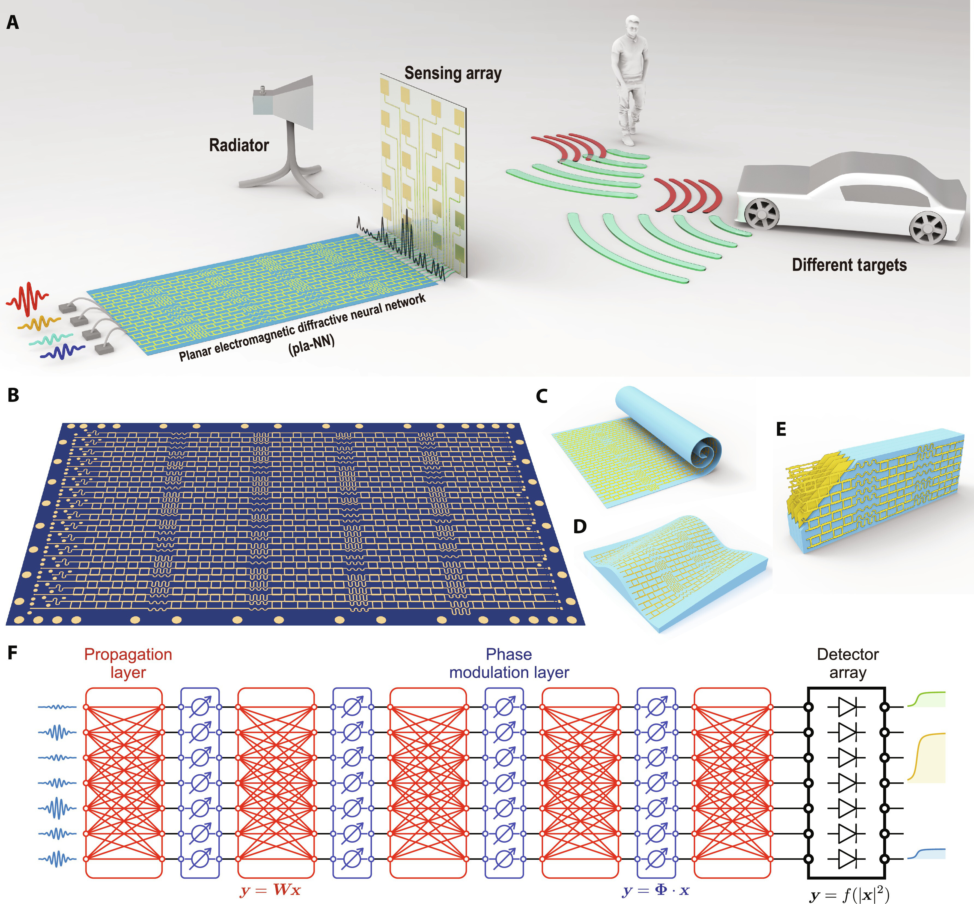
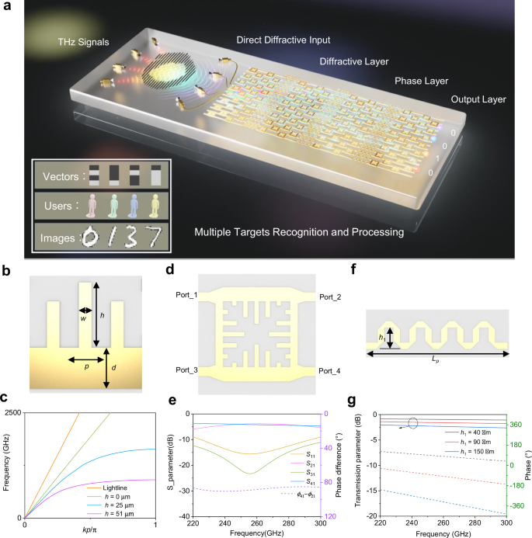
Metasurface -> RF Circuit (Plane Diffractive NN)
[1] Direct electromagnetic information processing with planar diffractive neural network. Science Advances 2024
[2] Terahertz spoof plasmonic neural network for diffractive information recognition and processing. Nature Communication 2024
Notes:
Besides using light, researchers have also built diffractive neural networks with RF circuits. As shown in the figure, the input RF signal goes into the system through an antenna array and travels through a propagation module, like a coupler network. The weights are tuned using phase shifters, and at the end, power detectors are used to measure the output.
除了光学实现之外，近年来射频（RF）电路也逐渐被应用于衍射神经网络的构建。如图所示，输入的RF信号通过天线阵列注入到传播模块（如耦合器网络），并通过移相器实现权重的调节，最终可以通过功率检测器获取输出结果。

Slide 8

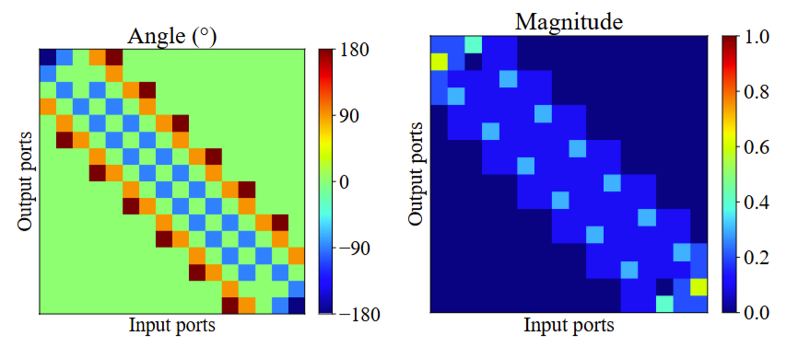
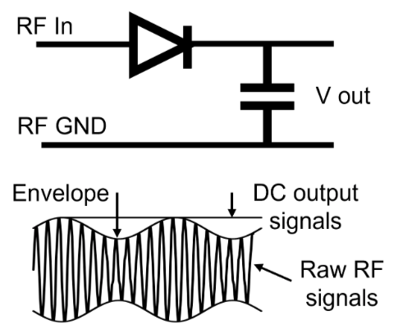



RF Circuit-based Diffractive NN
Input layer
Hidden layers
Output layer
$$W_{i}$$
$$B_{i}$$
$$W_{i+1}$$
…
Propagation weight matrix
Incident signals
Output DC signals
…
…
…
…
…
…
…
…
Antenna
Propagation module:
RF coupler network
Bias module:
Phase shifters
Output module
Port 1
Port 2
Power Detector
RF Coupler
Module
Port 4
Port 3
RF Phase
Delay Line
Port 1
Port 2
Notes:
Now, let’s break down how each layer works in RF circuit-based diffractive neural networks.
【click】 First, the diffraction matrix—similar to the air gap in optical networks—is built using RF coupler units.
【click】 If you look at the weight matrix for this part, you’ll notice it still has a symmetrical structure.
【click】 Next, for adjusting neuron weights, RF circuits use phase shifter units. These act like the bias module in traditional neural networks.
【click】 Finally, in the output layer, power detectors measure how strong each signal is. The detector with the highest intensity gives us the final result.
接下来，我们具体介绍一下用于实现基于射频电路的衍射神经网络中，每一层的射频电路结构。
【click】首先，原本光学神经网络中的空气间隙所对应的衍射矩阵，在射频实现中被射频耦合器单元所替代。将该权重矩阵可视化后，可以发现它依然呈现对称结构。
【click】其次，负责调节神经元权重的部分由移相器单元构成，用于实现偏置模块。
【click】最后，在输出层中，通过功率检测器对信号进行检测，依然是直接将强度最大的信号作为最终输出。

Slide 9
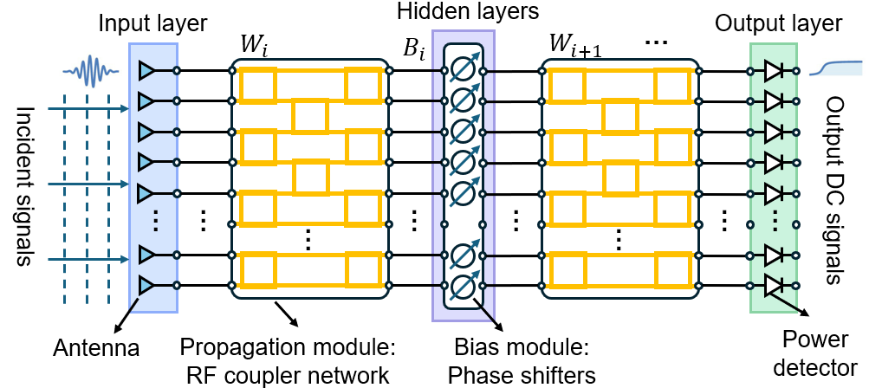
How to Build a Diffractive NN as a Digital NN?
Existing metasurface-based Diffractive NN:
- Limited adjustments of weights
- No non-linear activation
Existing RF circuit-based Diffractive NN:
- Limited adjustments of weights
- Not support complex value bias
- No non-linear activation
Detector array
(i.e., antenna)
Diffraction zones
Incident
waves
Secondary
wave
Meta-atom
Multi-layer
metasurface
Excitation
wave
Meta
-atom
How to design a physical diffractive NN that meets the following criteria:
Fully connected layers;
Freely adjustable weights and biases (with complex values);
Incorporation of nonlinear activation functions.
Notes:
When we look at current optical and RF-based diffractive neural networks, we still face some big challenges:
The range for adjusting weights is limited
There’s no support for complex-valued bias
And there’s no nonlinear activation function
So, the big question is: How can we build a physical diffractive neural network that’s fully connected, lets us adjust complex weights and biases however we want, and also includes nonlinear activation?
【click】 Our goal is to create a truly "learnable" physical network.
In other words, we want a system that can do these three things:
Support fully connected structures
Let us continuously and independently control every weight and bias—even complex ones
Add nonlinear activation so the network can better understand and fit complex patterns
These are the main reasons why digital neural networks are so powerful. Our goal is to bring all of these features into RF hardware as well.
综合现有的基于光学和射频电路的衍射神经网络方案，仍然面临以下几个问题：
• 权重调整的范围受限；
• 不支持复值偏置；
• 缺乏非线性激活。
因此，我们提出一个核心问题：
如何设计一个物理衍射神经网络，既能实现全连接和复值权重及偏置的灵活调节，又能够支持非线性激活？
【click】我们希望构建一个真正“可学习”的物理网络。
换句话说，我们希望它具备以下三项能力：
支持全连接传播结构；
每个权重和偏置都可以独立且连续地调节，包括复数权重；
具备非线性激活功能，从而拥有更强的表达和拟合能力。
这三个特征正是数字神经网络强大的根本。
我们的目标，就是在射频硬件层面，将这三点全面实现。

Slide 10
Our Solution: Design a novel RF circuit-based Diffractive NN
Input layers
Our contributions involve reconstructing these three modules
Hidden layers
Propagation modules
Activation modules
Bias modules
Output layers
…
…
…
…
…
…
…
Incident signals
Output DC signals
…
…
…
…
…
Notes:
That’s why we’re introducing WDNN—the Weighted Diffractive Neural Network.
WDNN has three main parts: the Propagation Module, the Bias Module, and the Activation Module.
The Propagation Module lets us flexibly adjust complex weights. The Bias Module gives us control over complex biases for each neuron. And the Activation Module adds nonlinear responses.
By combining these three modules, WDNN can do everything a full neural network does—but it’s all built with analog RF circuits.
因此，我们提出了WDNN——加权衍射神经网络（Weighted Diffractive Neural Network）。
WDNN由三个核心模块组成：传播模块（Propagation Module）、偏置模块（Bias Module）、以及非线性激活模块（Activation Module）。
其中，传播模块实现可自由调节的复数权重；偏置模块对每个神经元的复数偏置进行控制；非线性激活模块则赋予网络非线性响应能力。
这三大模块的有机结合，使WDNN拥有完整的神经网络功能——且全部基于模拟射频电路实现。

Slide 11
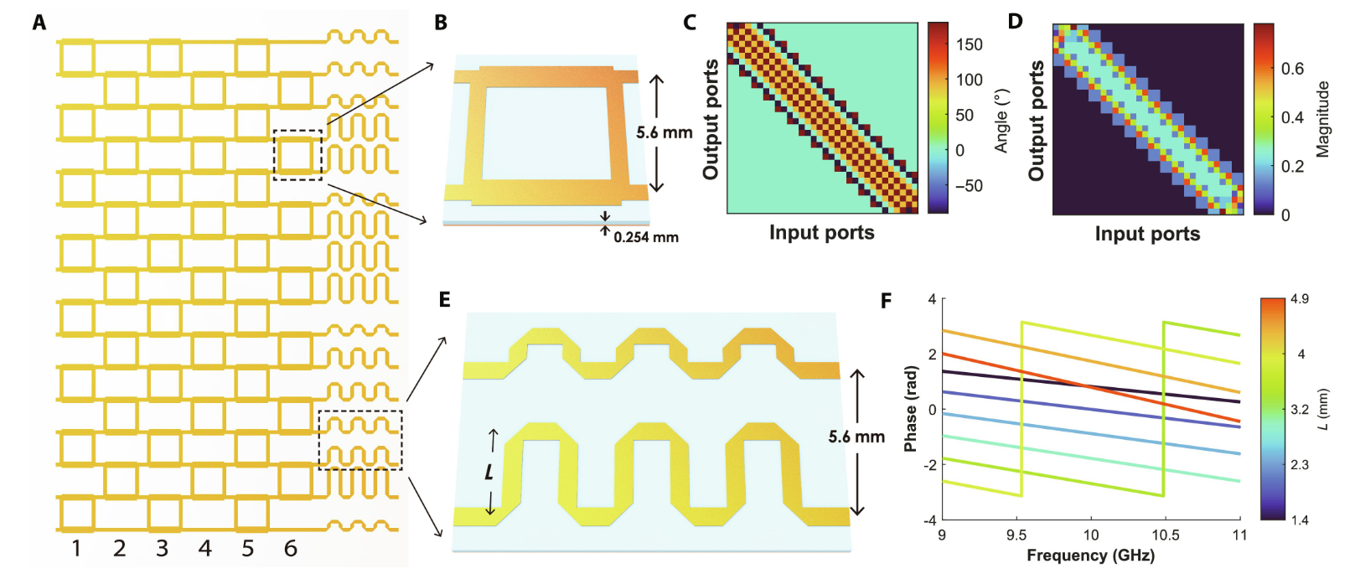


















































Propagation Modules: Full-connection, Free Weight Adjustment
$$W$$
RF Coupler Stacked Network
…
RF Coupler Unit
Physically implement
a propagation module
…
$${out}_{1}^{1}$$
$${out}_{1}^{2}$$
…
…
$${in}_{1}$$
$${out}_{1}$$
$$p_{1,1}$$
$${out}_{2}^{1}$$
$${out}_{2}^{2}$$
$$p_{k,1}$$
$$p_{N,1}$$
$${in}_{2}$$
$${out}_{2}$$
RF Coupler
$${in}_{3}$$
$${out}_{3}^{1}$$
$${out}_{3}^{2}$$
$$p_{k,2}$$
$${out}_{3}$$
Port 1
(${in}_{1}$)
Port 2
(${out}_{1}$)
$${in}_{4}$$
$${out}_{4}^{1}$$
$${out}_{4}^{2}$$
$${out}_{4}$$
$${in}_{5}$$
$${out}_{5}^{1}$$
$${out}_{5}^{2}$$
$${out}_{5}$$
Port 4
(${in}_{2}$)
Port 3
(${out}_{2}$)
$${out}_{6}^{1}$$
$${out}_{6}^{2}$$
$$p_{k,j}$$
$${in}_{6}$$
…
…
…
…
…
$${out}_{6}$$
…
…
…
…
$${out}_{2M−1}^{1}$$
…
$${out}_{2M−1}^{2}$$
…
…
$${in}_{2M−1}$$
$${out}_{2M−1}$$
$${in}_{2M}$$
$${out}_{2M}^{1}$$
$${out}_{2M}^{2}$$
$$p_{k,M}$$
$$p_{N,M}$$
$${out}_{2M}$$
$$P_{1}$$
$$P_{2}$$
…
$$P_{k}$$
$$P_{k+1}$$
…
$$P_{N−1}$$
$$P_{N}$$
Notes:
Let’s start by looking at why regular RF circuits can’t give us fully connected layers with freely adjustable RF weights.
【click】Normally, the propagation module in RF circuits uses RF coupler units. In each layer, these couplers just split the energy from port 1 and port 4 to port 2 and port 3.
首先，让我们来分析为什么传统的RF射频电路无法实现全连接且可自由调节的射频权重。
【click】在原有的射频电路中，传播模块通常由射频耦合器单元组成。每一层的射频耦合器负责将从port1和port4输入的能量分散到port2和port3

Slide 12
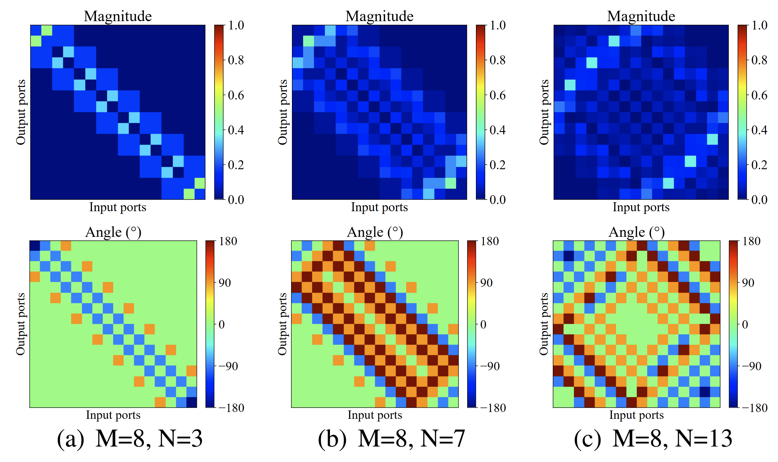
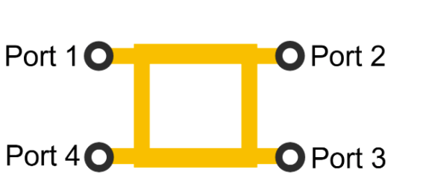
















































RF Coupler Unit
$${out}_{1}^{1}$$
$${out}_{1}^{2}$$
…
…
RF Coupler
$${in}_{1}$$
$${out}_{1}$$
Port 1
(${in}_{1}$)
Port 2
(${out}_{1}$)
$${in}_{2}$$
$$p_{1,1}$$
$${out}_{2}^{1}$$
$${out}_{2}^{2}$$
$$p_{k,1}$$
$$p_{N,1}$$
$${out}_{2}$$
$${in}_{3}$$
$${out}_{3}^{1}$$
$${out}_{3}^{2}$$
$${out}_{3}$$
Port 4
(${in}_{2}$)
Port 3
(${out}_{2}$)
$${in}_{4}$$
$${out}_{4}^{1}$$
$${out}_{4}^{2}$$
$$p_{k,2}$$
$${out}_{5}^{2}$$
$${out}_{4}$$
$${in}_{5}$$
$${out}_{5}^{1}$$
$${out}_{5}$$
$${in}_{6}$$
$${out}_{6}^{1}$$
$${out}_{6}^{2}$$
$$p_{k,j}$$
$${out}_{6}$$
…
…
…
…
…
…
…
…
…
…
$${in}_{2M−1}$$
$${out}_{2M−1}^{1}$$
…
$${out}_{2M−1}^{2}$$
…
$$p_{k,M}$$
$$p_{N,M}$$
$${out}_{2M−1}$$
$${in}_{2M}$$
$${out}_{2M}^{1}$$
$${out}_{2M}^{2}$$
$${out}_{2M}$$
$$P_{1}$$
$$P_{2}$$
…
$$P_{k}$$
$$P_{k+1}$$
…
$$P_{N−1}$$
$$P_{N}$$
Equal RF Coupler Network’s weights
- Limited adjustment space
Notes:
The -3dB couplers in standard circuits split the input power evenly between two output ports.
【click】 This creates “symmetric coupling,” which keeps the propagation matrix symmetric.
【click】 But this symmetry limits the network’s weight space, so it can’t learn more complex mappings during training.
That’s why we need to break this symmetric relationship and build a propagation channel that’s tunable and non-uniform.
在原电路中采用的-3dB耦合器，会将输入端的功率平均分配到两个输出端，这种“对称耦合”使得传播矩阵始终保持对称性。
【click】这一限制导致网络的权重空间不完整，使其在训练过程中无法收敛到复杂的映射。
因此，我们必须打破这种对称耦合关系，构建一个“非均匀、可调节”的传播通道，赋予网络更强的表达能力。

Slide 13

























We Propose a Novel Design: Weighted and Asymmetric RF Coupler
RF unequal power
splitter and combiner
RF unequal coupler
RF phase delay lines
$$W_{2}$$
$$L_{m2}$$
$$L_{c}$$
Port 1
RF in1
port 1
$$D_{l}$$
$$D_{m3}$$
$$D_{c1}$$
$$L_{2}$$
$$D_{1}$$
port 2
Port 2
RF out1
$$D_{m4}$$
$$R_{c}$$
$$D_{c2}$$
port 1
port 2
port 1
port 2
Isolation Resistors
$$S_{1}$$
$$D_{2}$$
$$D_{l}$$
$$D_{s1}$$
$$W_{1}$$
Port 4
RF in2
port 3
port 4
port 3
$$R_{s}$$
$$D_{l}$$
Port 3
RF out2
port 4
$$D_{s2}$$
$$D_{m2}$$
$$L_{3}$$
port 4
port 3
$$D_{l}$$
$$L_{s}$$
$$L_{m1}$$
$$S_{2}$$
Notes:
To solve this problem, we’ve designed a weighted asymmetric coupler.
Our circuit has three main parts: an unequal power splitter, a phase delay line, and an asymmetric coupler. This lets us control the coupling ratio and phase much more flexibly.
It’s important to know that if we only use an unequal coupler, energy from port 1 will be split unevenly between port 2 and port 3—but from port 1 to port 4, the distribution and phase will still be symmetric because of how the circuit works.
To break this symmetry, we add Wilkinson power splitters and combiners to move energy around, and use adjustable phase delay lines to align the phase and reduce loss. The unequal power splitter then allows us to set any energy splitting ratio and precisely control the phase.
为此，我们提出了一种加权非对称耦合器。
我们的电路方案由三部分组成，核心思想是通过不等功率分配器（unequal power splitter）、可调节相移线（phase delay line）和非对称组合，实现任意耦合比例与灵活的相位控制。
需要注意的是，仅使用RF不等耦合器时，虽然从port1输入的能量会因不对称性在port2和port3呈现不同分配，但由于结构本身的对称性，port1与port4之间的能量分配和相位变化仍然是对称的。
为了解决这一问题，我们采用维尔金森功分器和功合器实现能量的偏移与打破对称性，可调节相移线用于相位校准，从而避免能量损失。最终，通过不等功率分配器能够实现任意比例的能量分配和相位控制。

Slide 14
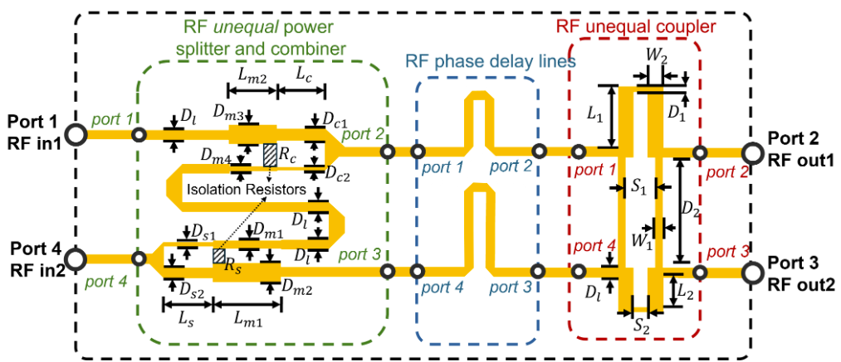
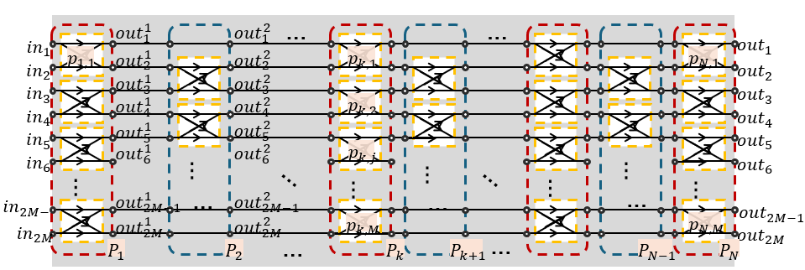
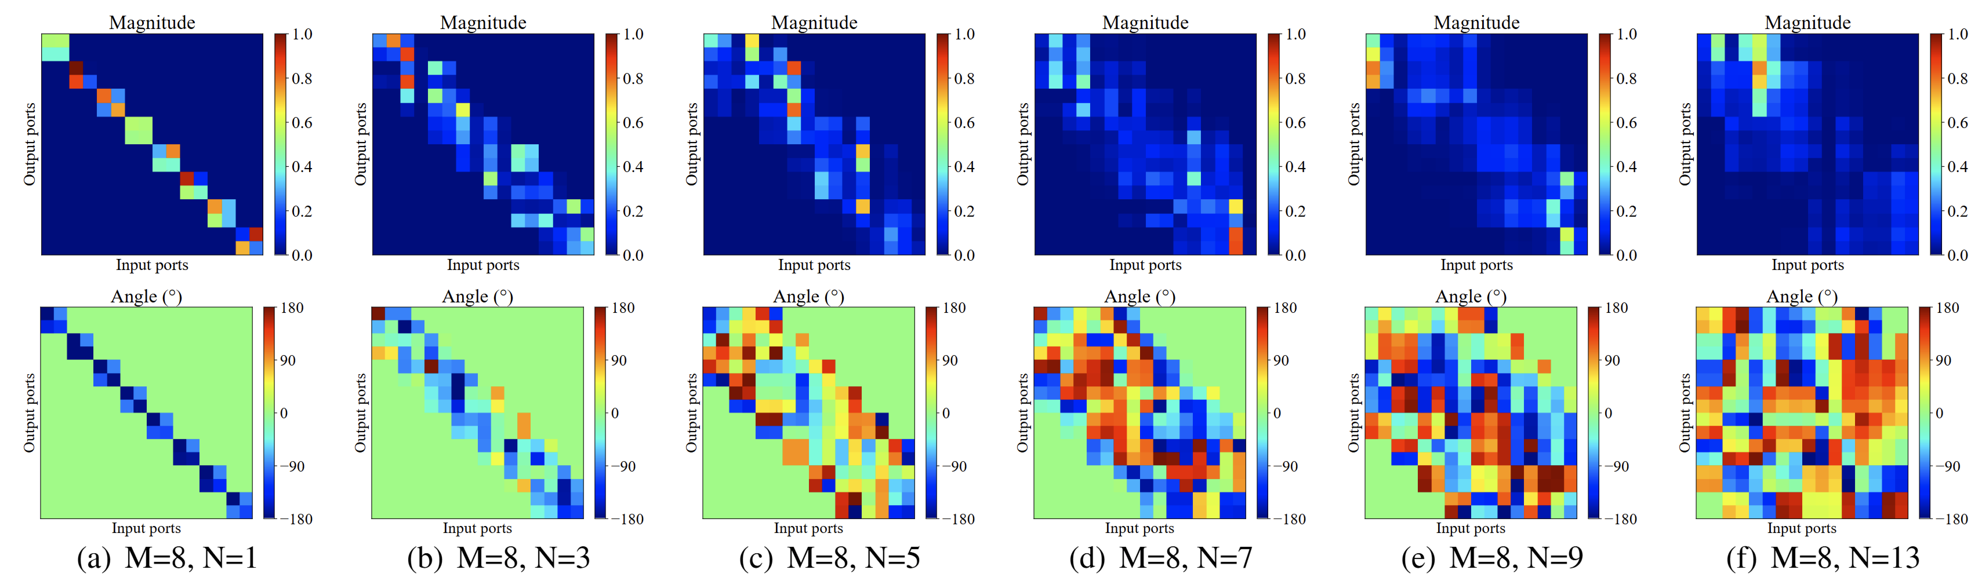
RF Coupler Network with Our Proposed Unit
Notes:
By adjusting these parameters, we can independently control both the amplitude and phase of each connection channel between two layers of neurons.
This allows our propagation module to act as a “fully adjustable matrix.”
【click】 Mathematically, it means we can perform any complex linear transformation. And from an engineering point of view, it’s still a completely analog RF network.
If we look at the amplitude and phase changes in the fully connected layer, you’ll see that the new transmission matrix breaks the old symmetry and can now fit any energy pattern we need.
通过灵活调节这些参数，我们可以使两层神经元之间每一个连接通道的复数权重（即幅度和相位）实现独立调节。
这使得整个传播模块具备了“全矩阵可调”的功能。
从数学角度来看，这相当于实现了一个复数线性变换层；而从工程实现上，它依然保持为一个纯模拟的射频网络。
【click】通过对全连接层的幅值和相位变化进行可视化，我们发现所实现的传输矩阵已经突破了原本的对称性，实现了对任意能量矩阵的精准拟合。

Slide 15
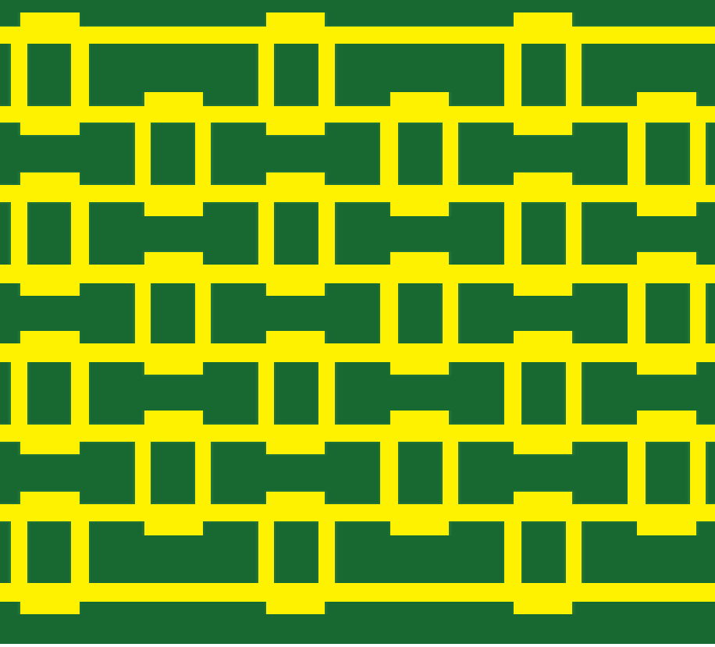

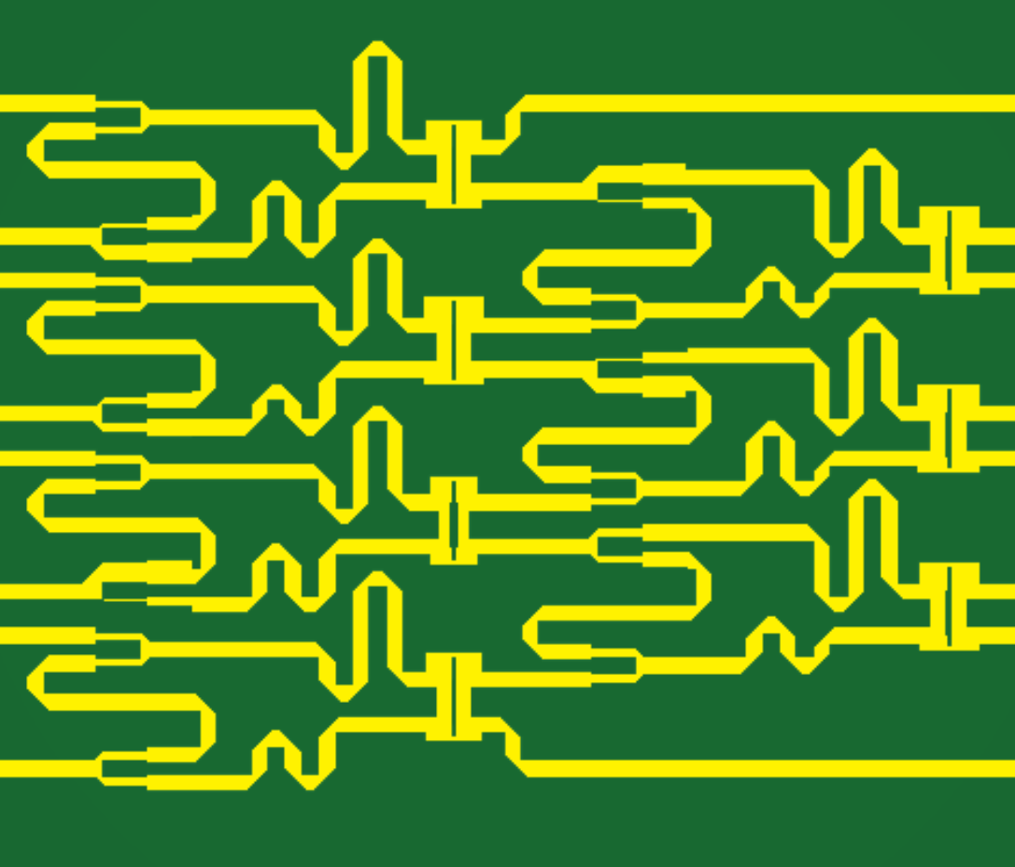
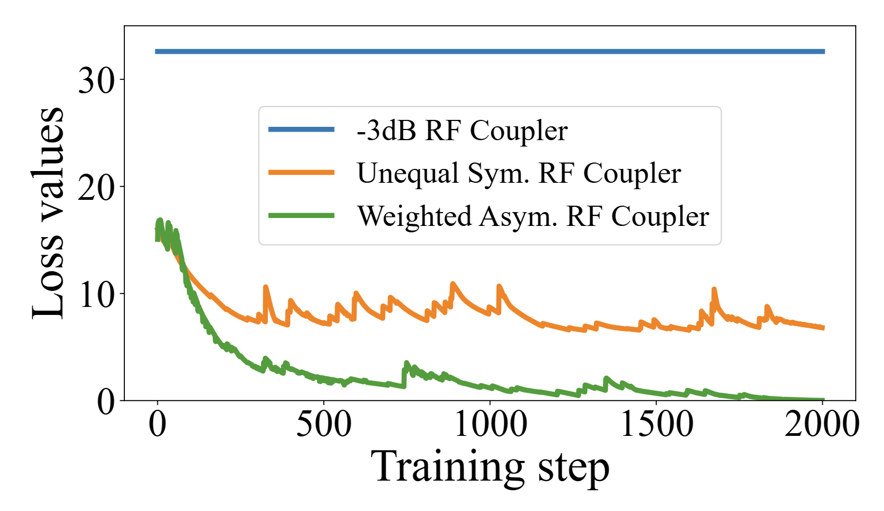
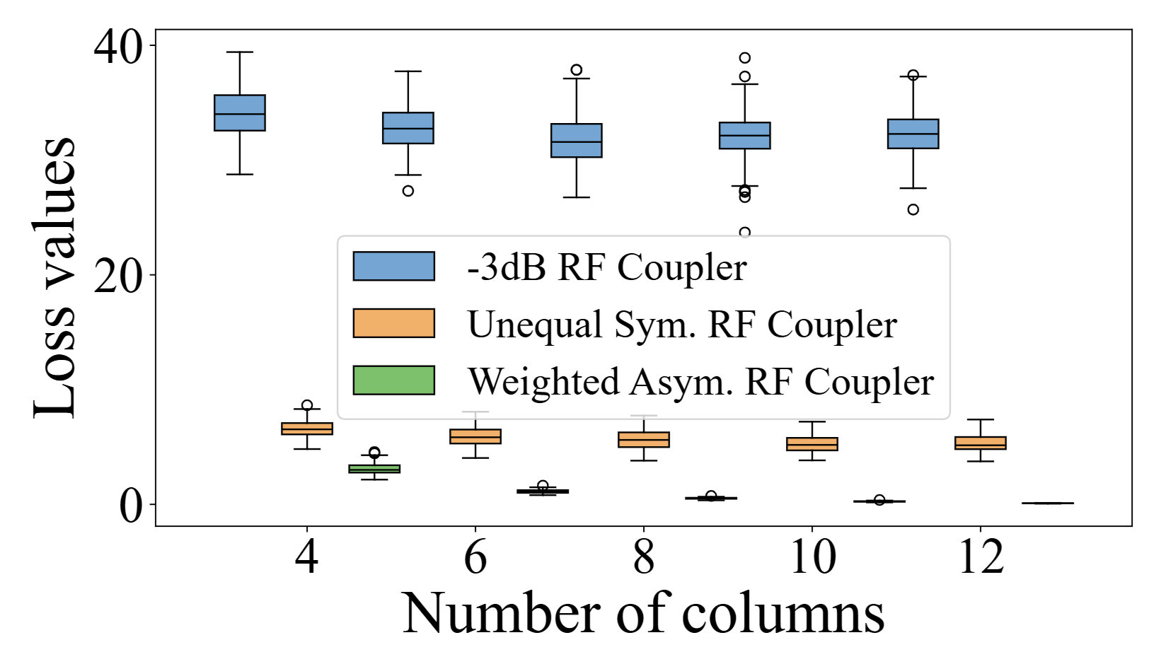
Fitting Ability of Different RF Coupler Networks
-3dB RF Coupler Network
Unequal Sym. RF Coupler Network
Weighted Asym. RF Coupler Network
Notes:
To show why these extra structures are important, we ran an experiment with three different setups on a random connection matrix.
First, we tried the standard -3dB coupler, then we swapped in asymmetric couplers, and finally we used our full setup—with splitters, phase delay lines, and asymmetric couplers.
The result shows: The -3dB coupler couldn’t fit the matrix well at all. Asymmetric couplers did better, but still didn’t fully fit the target. But with our complete configuration, we were able to fit any random matrix perfectly.
We also checked what happened if we added more layers. The -3dB coupler didn’t improve, asymmetric couplers were still limited, but our weighted asymmetric RF coupler gave perfect fitting every time, no matter how many layers we used.
为验证我们所引入的额外结构的必要性，我们假设了一个随机连接矩阵，并分别进行了三种方案的拟合对比：
（1）仅使用原始的-3dB耦合器；
（2）将-3dB耦合器单元更换为非对称耦合器单元；
（3）采用完整的结构，包括不等功率分配器、可调节相移线以及非对称耦合器单元，形成最终的传输矩阵。
通过对比，结果显示原始的-3dB耦合器由于缺乏调节能力，其与目标随机矩阵的损失（loss）始终保持在一个较高且固定的数值；替换为非对称耦合器后，损失有所下降，但仍无法完全拟合目标随机矩阵；而采用包含功分、功合和相位延迟线的完整加权非对称射频耦合器后，最终的拟合结果能够实现对任意随机矩阵的完全拟合。
此外，我们还研究了耦合层数对拟合能力的影响。结果表明，随着层数增加，-3dB耦合器的拟合能力依然有限；仅使用非对称耦合器时拟合能力有所提高；而采用完整的weighted asym RF coupler，则能够完全拟合任何随机全连接矩阵。

Slide 16







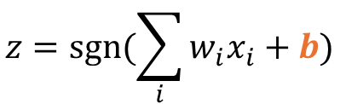

Bias Module: RF Shifters Supported Complex Value
$$1$$
$$x_{1}$$
$$b$$
$$w_{1}$$
RF attenuator
RF phase delay line
$$x_{2}$$
$$y$$
$$z$$
$$w_{2}$$
$$∑$$
sgn
port 1
port 2
$$D_{l}$$
$$x_{3}$$
$$w_{3}$$
$$R_{2}$$
port 1
port 2
$$z=sgn⁡(\sum_{i}{w_{i}x_{i}}+b)$$
$$R_{1}$$
$$R_{1}$$
$$L_{p}$$
RF phase delay line
RF GND
$$D_{p}$$
Port 1
Port 2
$$b={A e}^{jθ}$$
$$b=e^{jθ}$$
Notes:
Next, let’s talk about how we add the bias module for each neuron.
In WDNN, we’ve managed to create a tunable "complex bias." We connect a tunable attenuator and a phase shifter in series—the attenuator controls signal strength, and the phase shifter changes the signal’s phase.
With these two components together, we can produce any complex bias we want.
接下来，介绍神经网络节点的偏置模块的实现方法。
在数字神经网络中，偏置（bias）项能够帮助模型在特征空间中实现平移，从而提升网络的拟合能力。在WDNN中，我们实现了“复数偏置”的可调功能。具体做法是，将可调衰减器（attenuator）与相移器（phase shifter）串联。衰减器用于控制信号的幅度，相移器则调节信号的相位，两者结合即可生成任意的复数偏置。这样，每个神经元不仅可以独立调节“信号强度”，还可以灵活控制“信号相位”，实现真正的复数偏置调整能力。

Slide 17

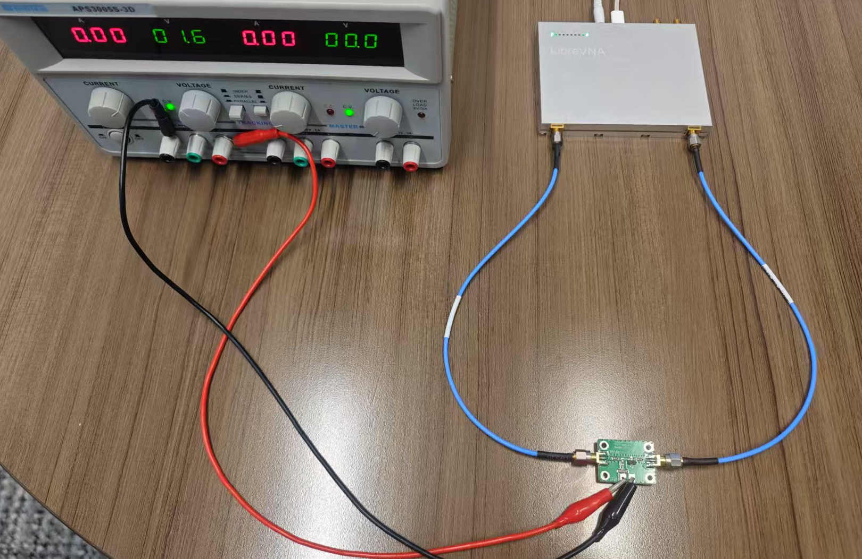

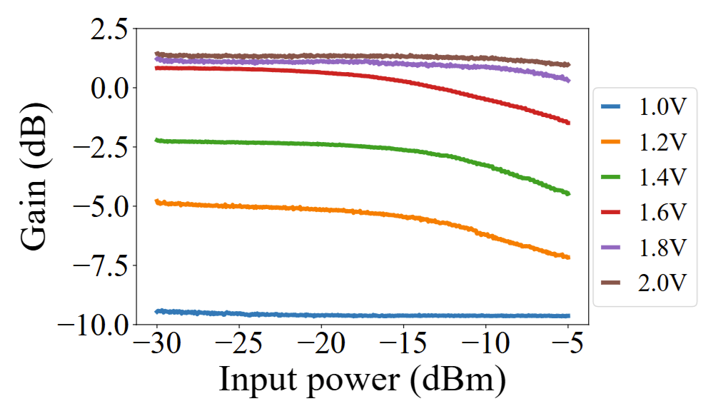
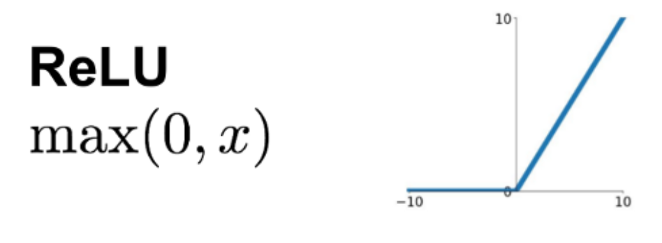




Non-linear Activation Module
GND
Vcc
$$C_{A}$$
Power supply
LibreVNA
RF Amplifier
$$L_{A}$$
RF in
RF out
RF amplifier
$$C_{B}$$
$$C_{B}$$
GND
Notes:
In digital networks, adding nonlinear activation with functions like ReLU is easy, but it’s much harder in analog circuits.
Our solution is: we use the natural nonlinearity in RF amplifiers.
【click】 By lowering the supply voltage, we get a response a lot like ReLU—
【click】 low input gives almost zero output, and once the input crosses a threshold, the output jumps up.
So, with this approach, WDNN now supports weights, bias, and activation—all in hardware.
众所周知，非线性激活函数是神经网络的核心——没有激活函数，网络就会变成一个线性系统，无法学习复杂的映射关系。
在数字神经网络中，我们可以轻松地使用ReLU、Sigmoid等各种函数。但在模拟电路中，实现非线性激活依然非常具有挑战性。
对此，我们提出了创新的解决方案：利用射频放大器本身的非线性特性。当放大器工作于饱和区或截止区时，输入与输出之间会产生明显的非线性关系。我们通过调节供电电压，使放大器进入轻微饱和状态，从而获得类似于ReLU的性能表现：当输入信号较低时，输出接近于零；而输入信号超过一定阈值后，输出会迅速上升。
这种做法非常巧妙——它充分利用了硬件自身的物理特性，实现了神经网络所需的激活功能。
从系统角度来看，至此，WDNN已经具备了权重、偏置和激活这三个完整的功能模块。

Slide 18
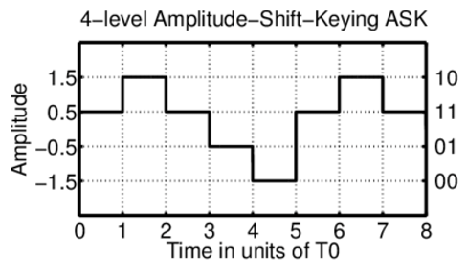

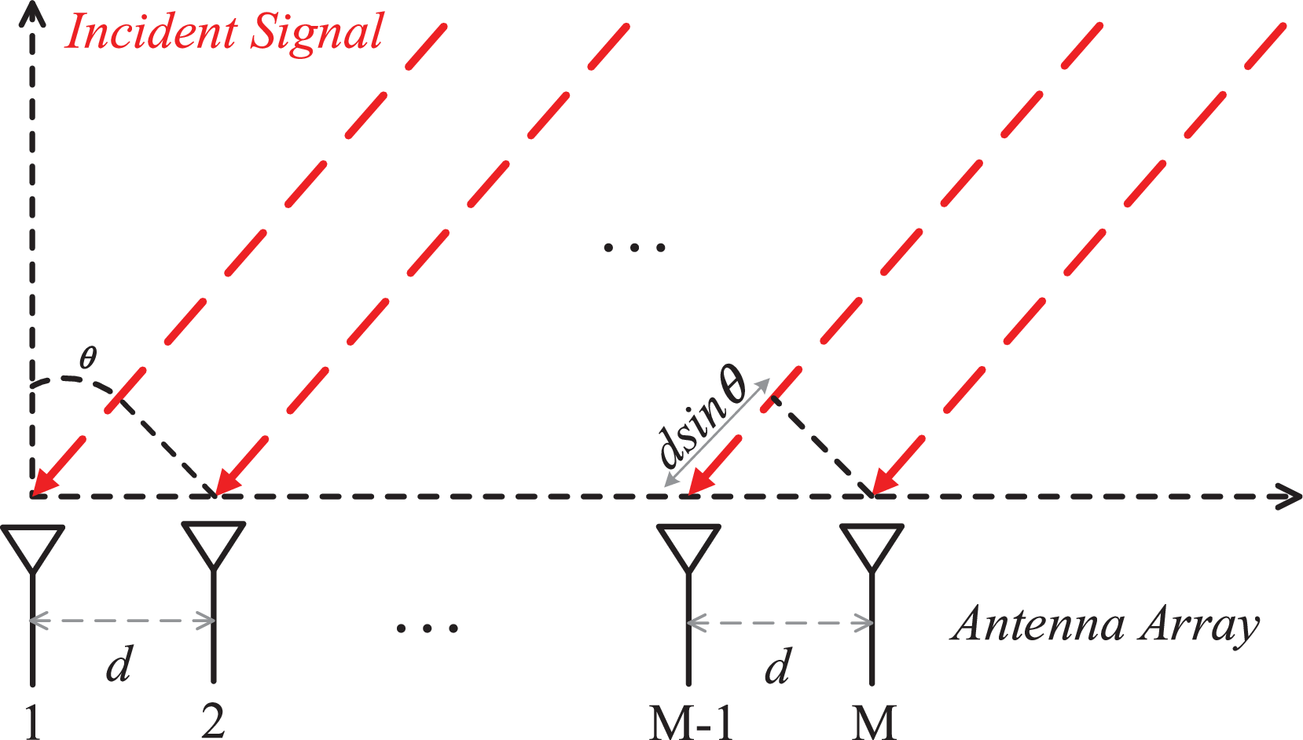
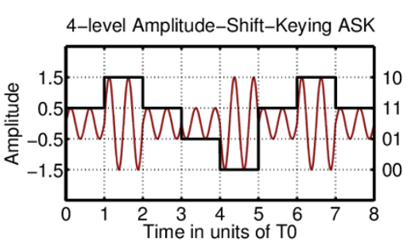
Applications
Amplitude shift keying
decoding
Angle of arrival
estimation
Fall detection
with Wi-Fi CSI
Notes:
To test how well our device works, we picked three common applications to evaluate the WDNN system.
These include multi-level amplitude shift keying modulation, angle of arrival detection, and fall detection.
These three tasks cover a range of applications—from communication signal recognition to wireless sensing—which shows how versatile WDNN really is.
为了验证我们设备的实际效果，我们选择了三项主流应用，对所提出的WDNN系统的有效性进行了测试。
分别是：多级幅度移位键控（multi-level amplitude shift keying modulation）、到达角检测（angle of arrival detection），以及跌倒检测（fall detection）。

Slide 19
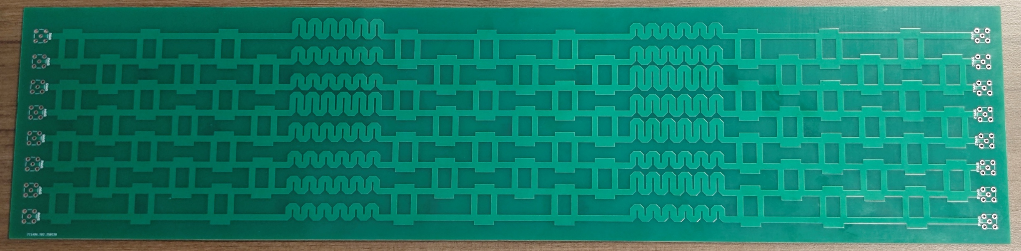
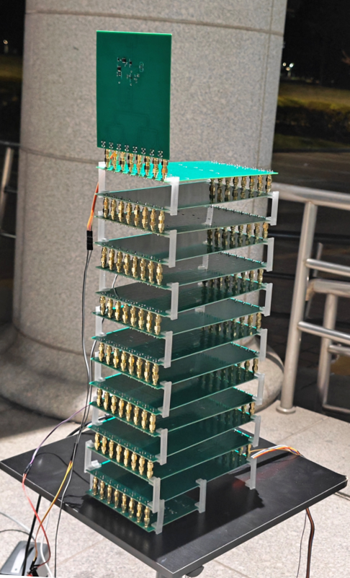
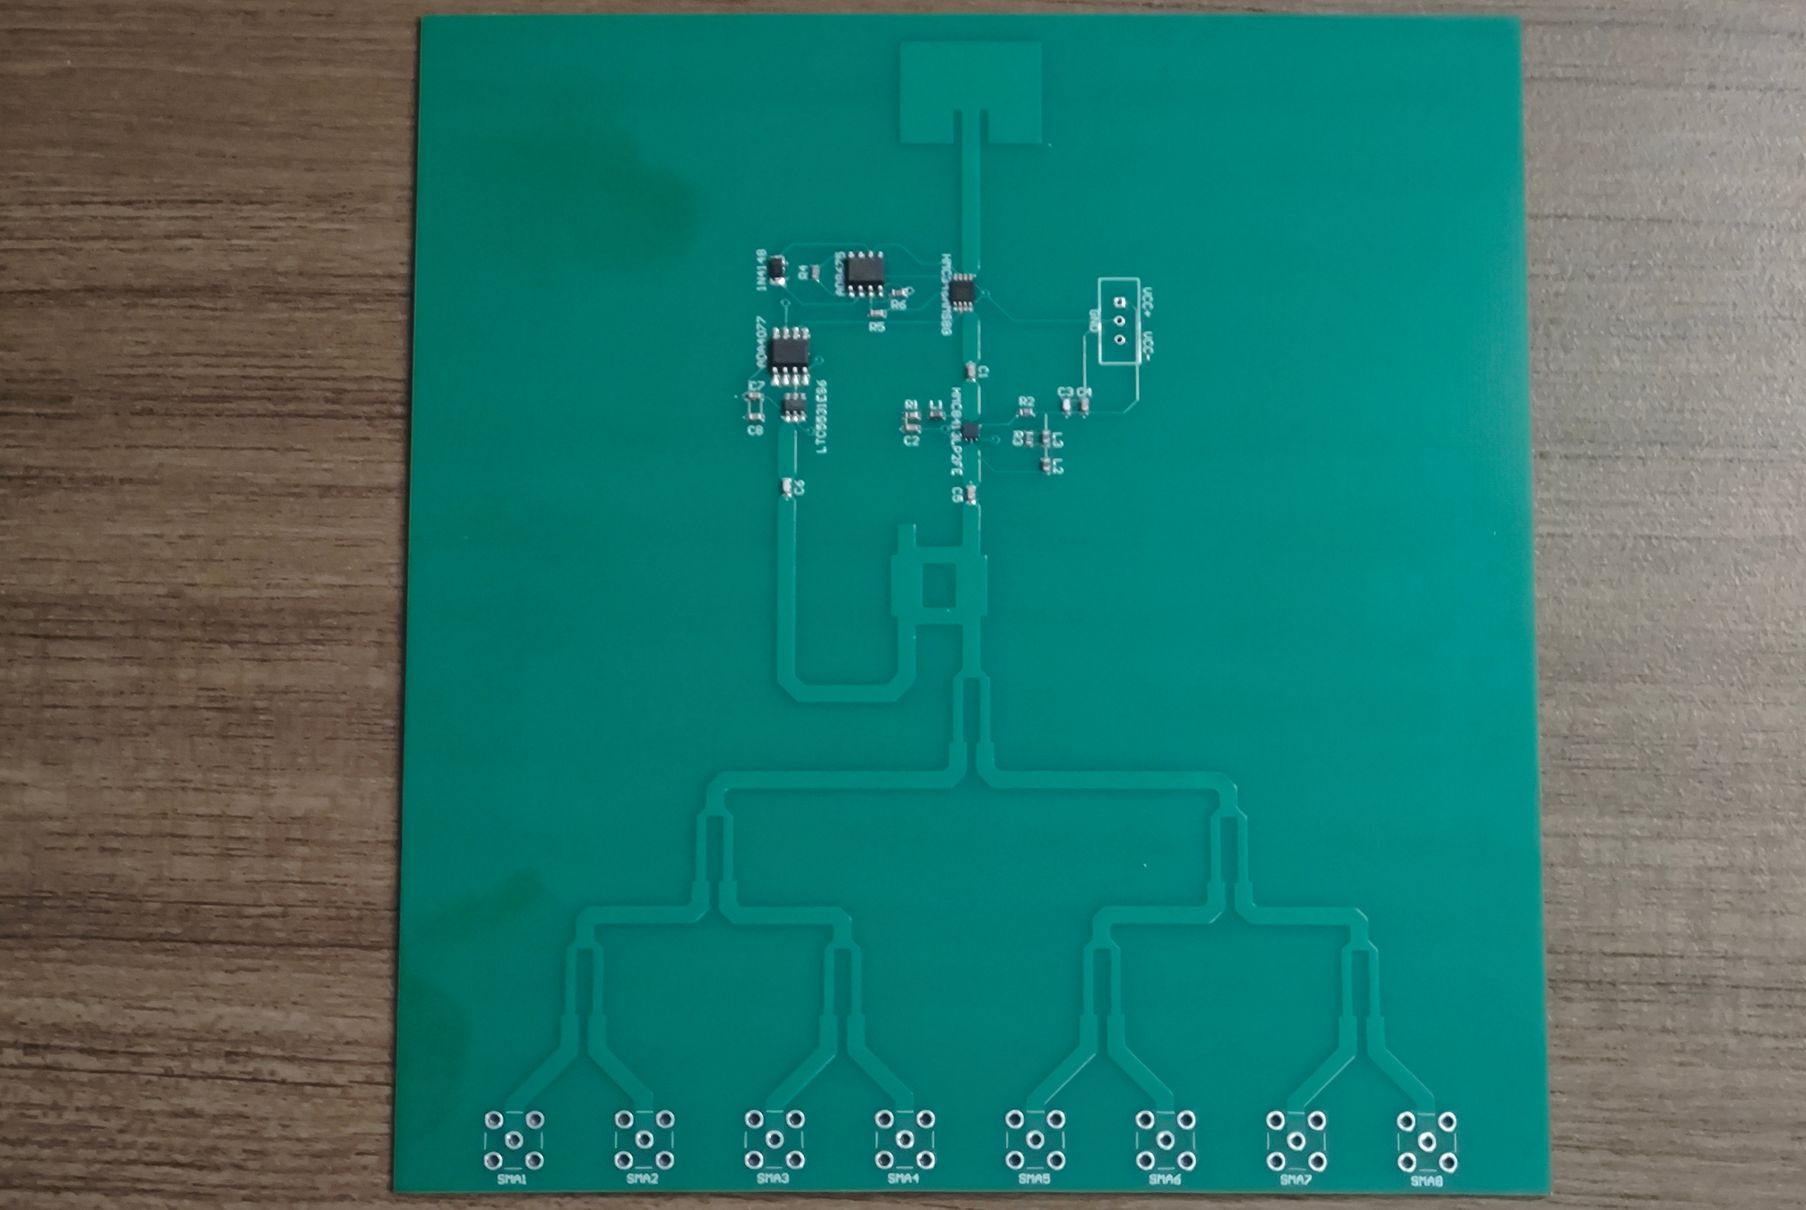
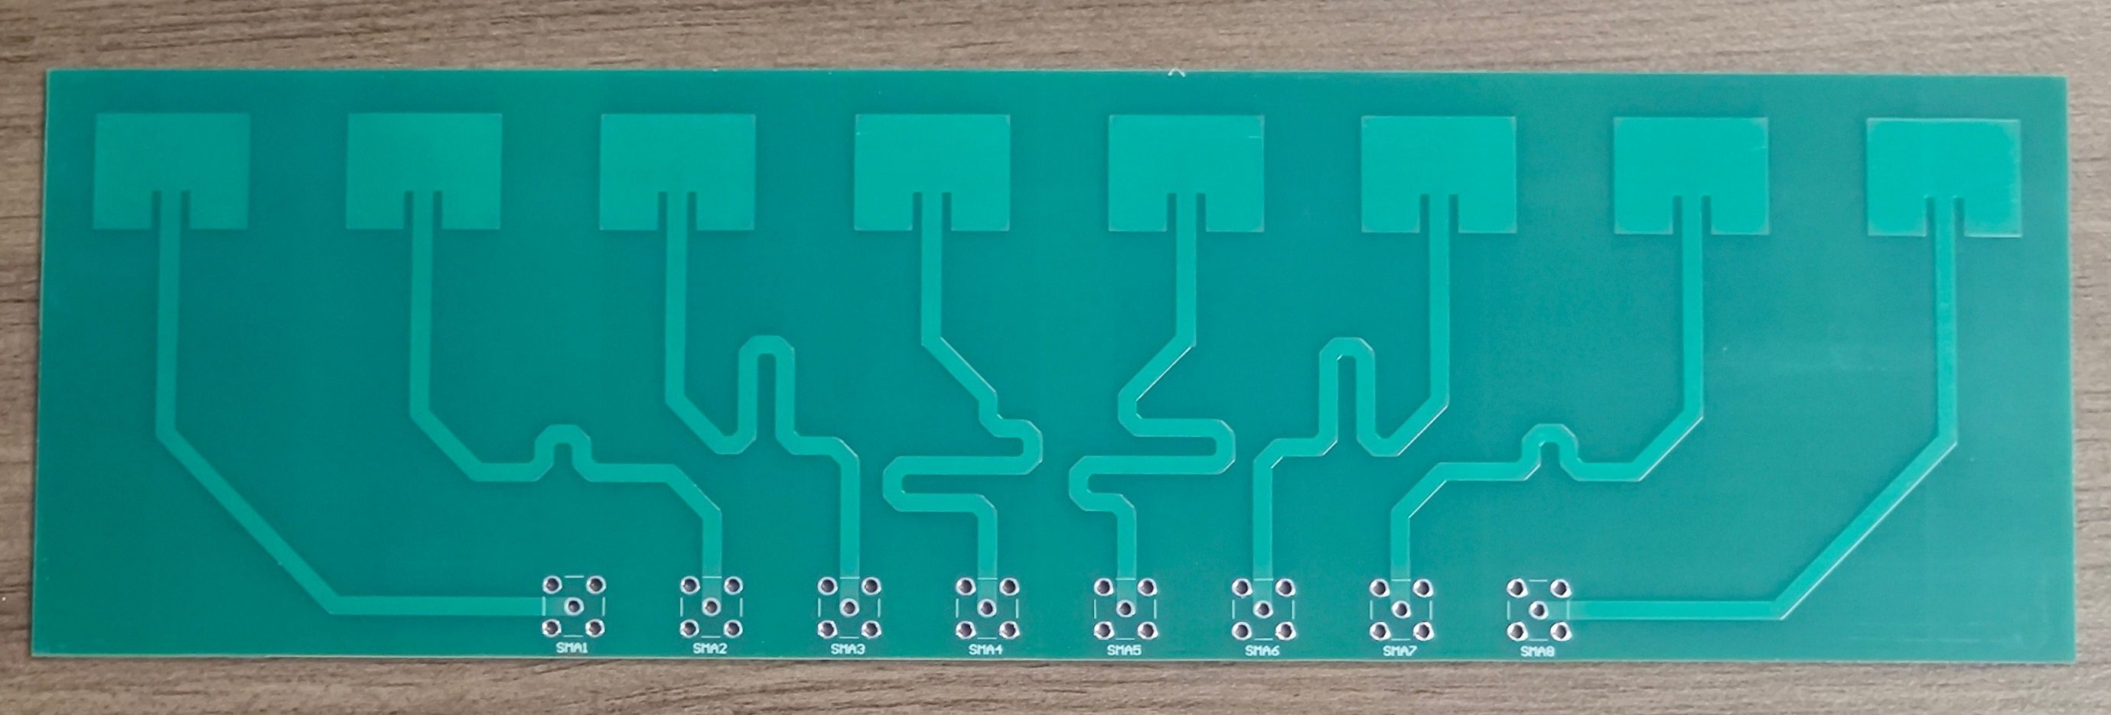
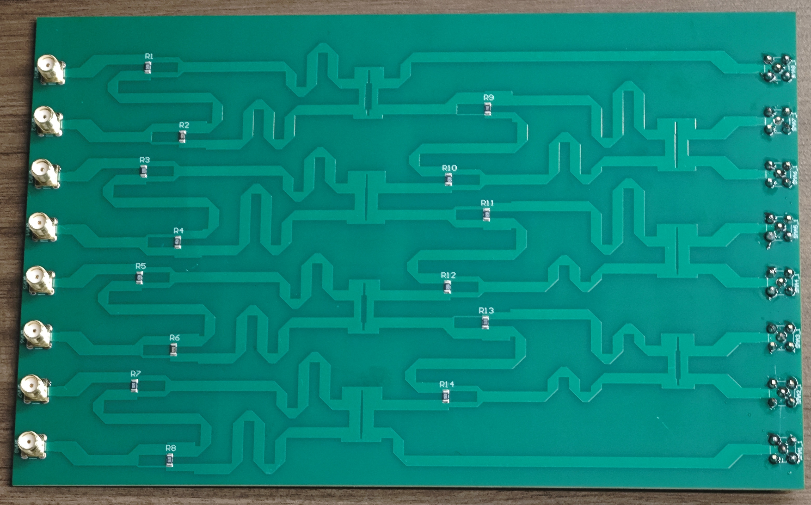
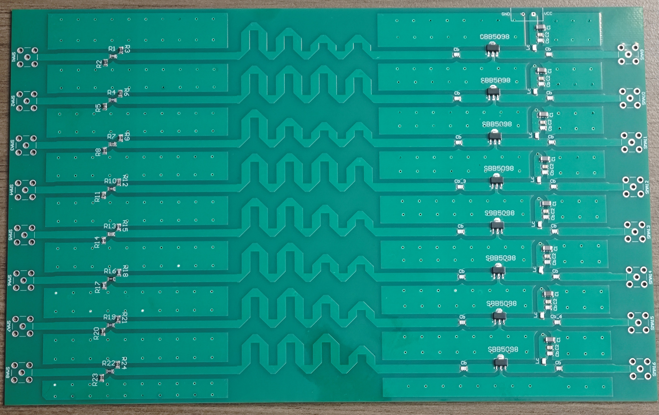
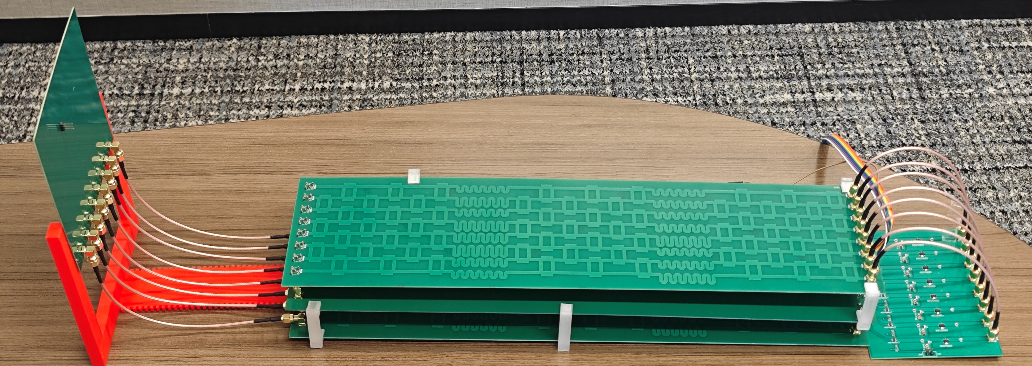
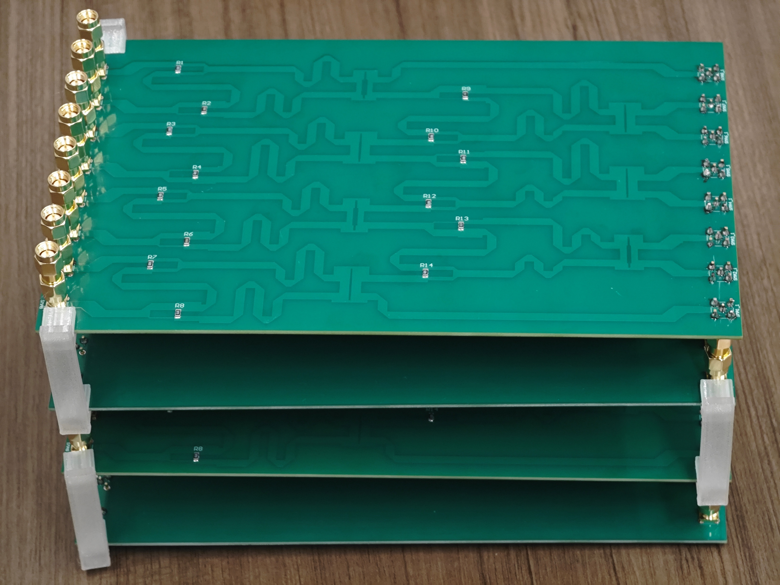
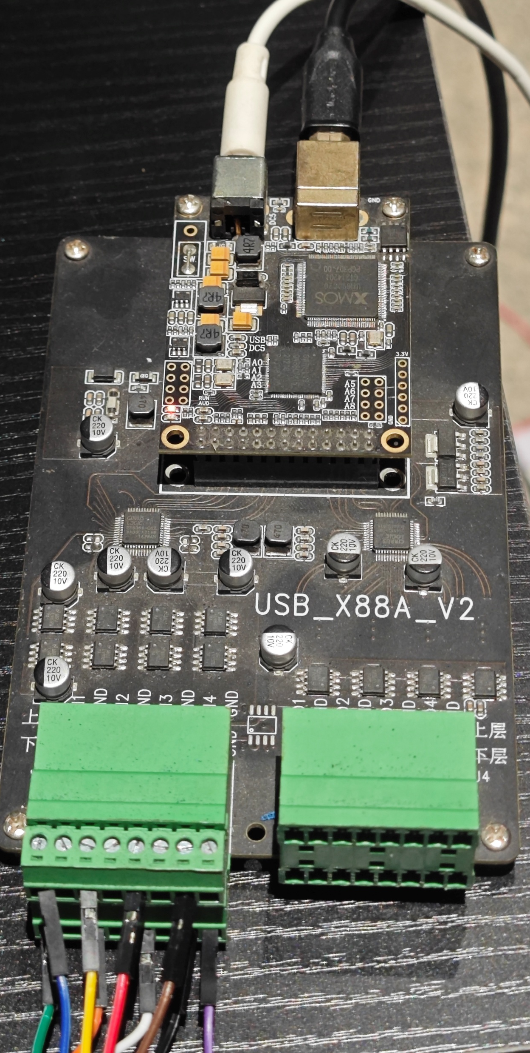
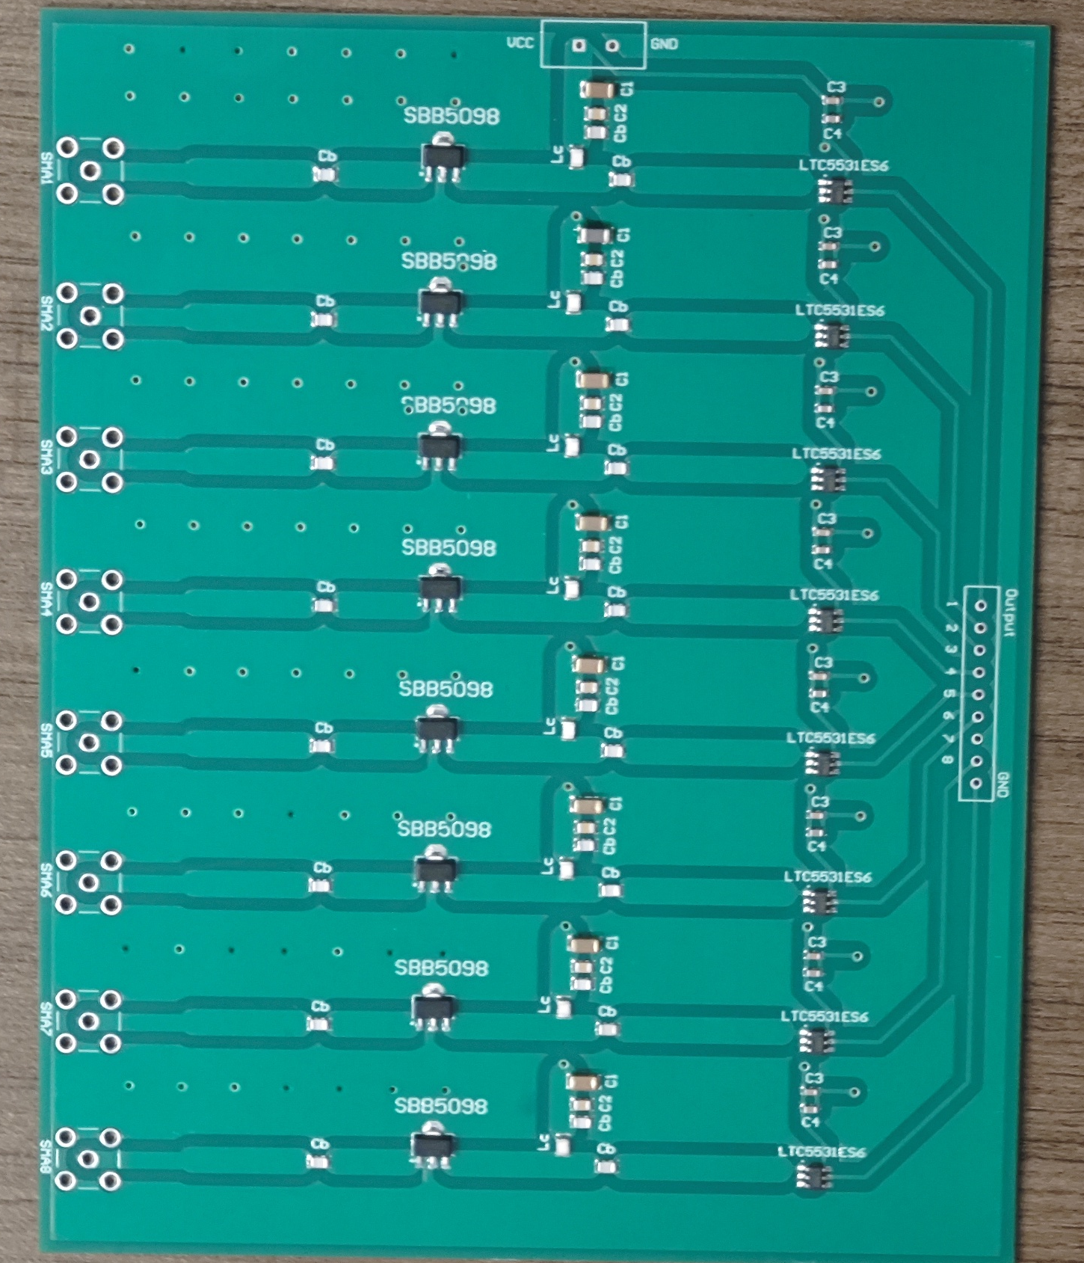














Input Layer:
Antenna
WDNN Prototype
Patch
antenna
Patch antenna array for AoA estimation tasks
RX Antenna
AGC
module
Power
splitter
$$W$$
$$b$$
$$W$$
$$b$$
$$W$$
Propagation
modules
Propagation
Module
($M=4, N=6$)
Bias
module
Input Module
Equal
RF coupler
Bias and
Activation
modules
(i)
Weighted asymmetric
RF coupler
(iii)
$$b$$
$$tau$$
antenna
Power detector array
Pla-NN
(13cm x 52cm x 6cm)
$$W$$
Bias
Module
Activation
Module
$$b$$
$$tau$$
(ii)
$$W$$
One propagation module between two layers
Output Module
$$W$$
$$b$$
$$tau$$
$$W$$
Feature
output layer
4 layers as a
Propagation Module
($M=4, N=8$)
Feature output
Power detector array
ADC
device
Notes:
We built a WDNN prototype system in our lab.
【click】 First, we use receiving antennas to keep the ASK power steady.
【click】 For the angle of arrival (AOA) task, the antenna is designed so that the phase between the antenna and the input ports is equal.
The network circuit has three main parts:
【click】 The WDNN board, which features couplers and phase shifters.
【click】 The propagation module, made up of multiple layers of WDNN boards.
【click】 The bias layer together with the activation module.
【click】 All of our experiments were performed in the standard 5GHz frequency band. All modules are connected by RF cables, and we use power detectors and ADCs to measure the output.
我们在实验室搭建了一个WDNN原型系统。
系统主要由四个部分构成：
用于保证ASK功率恒定和AOA相位一致的接收天线；
基于耦合器和相移器设计的WDNN主板；
偏置层与激活模块；
用于输出测量的功率检测器与ADC。
我们选用了标准的5GHz频段进行测试。
各模块之间通过射频线缆连接，最终通过ADC设备获取输出结果。

Slide 20
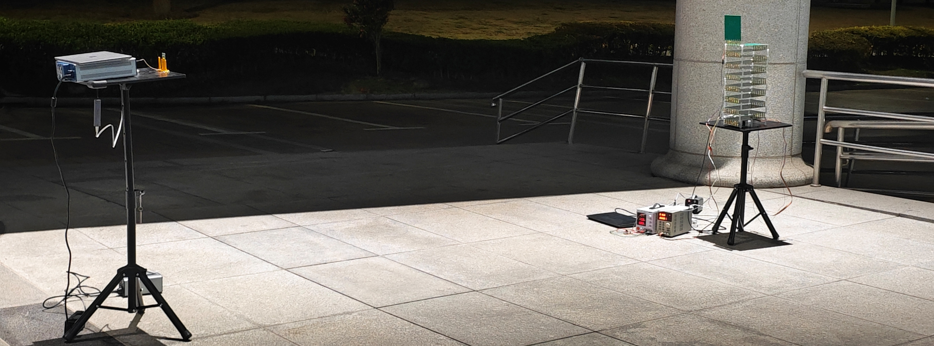
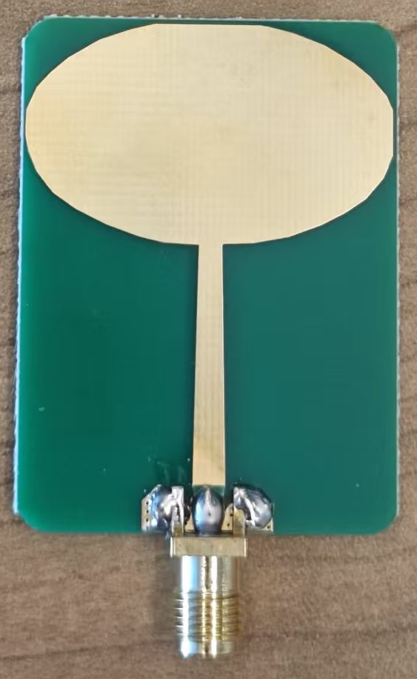
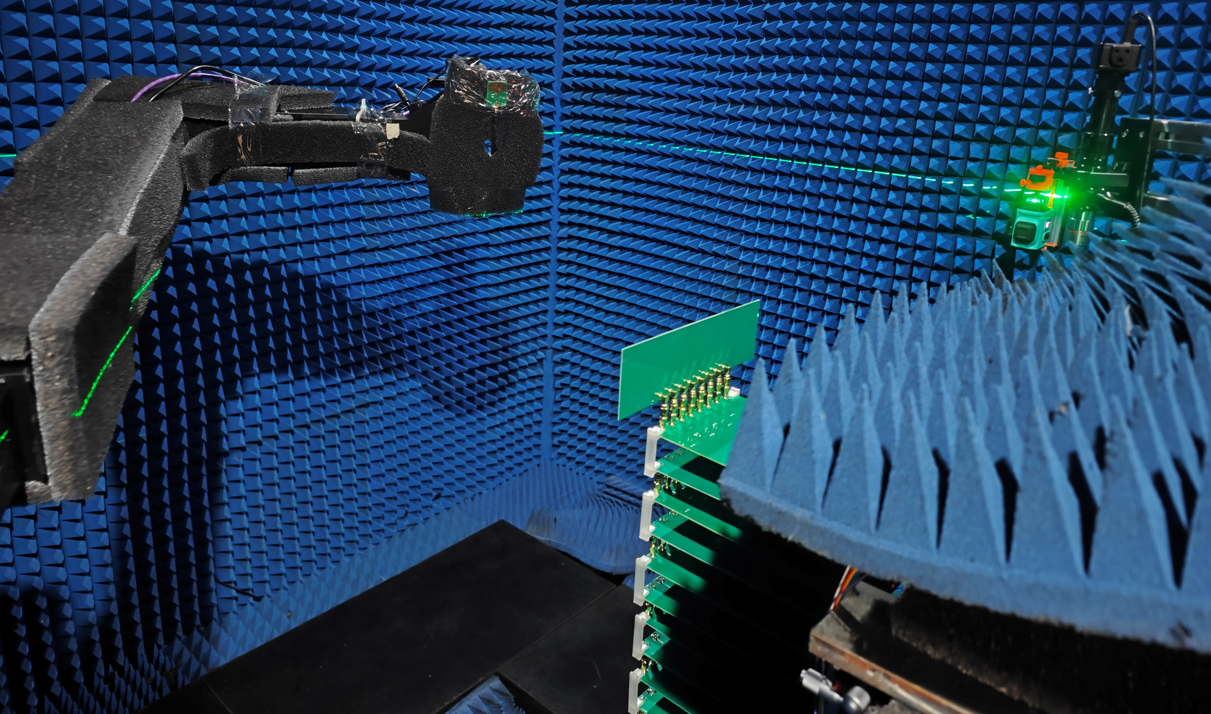
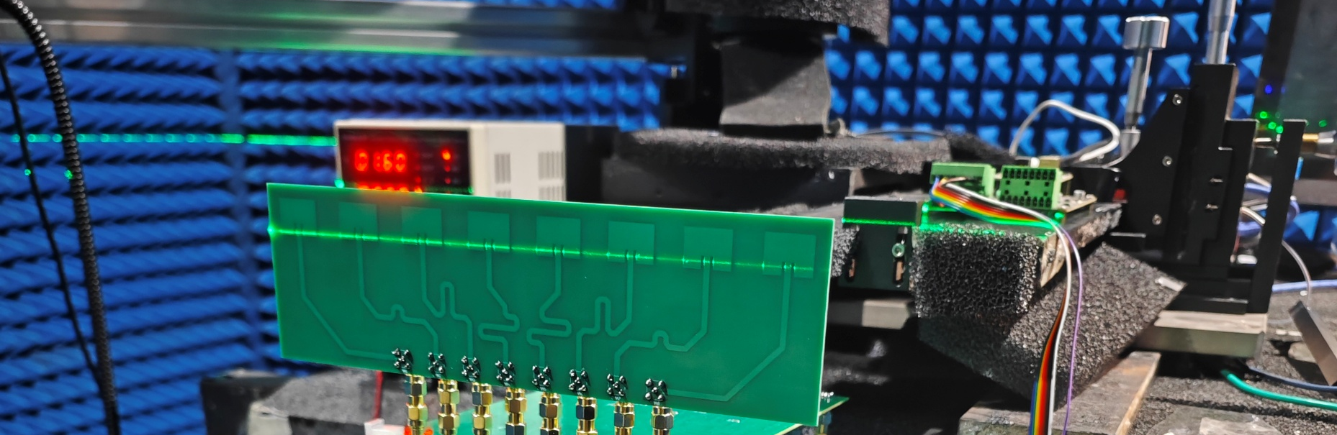
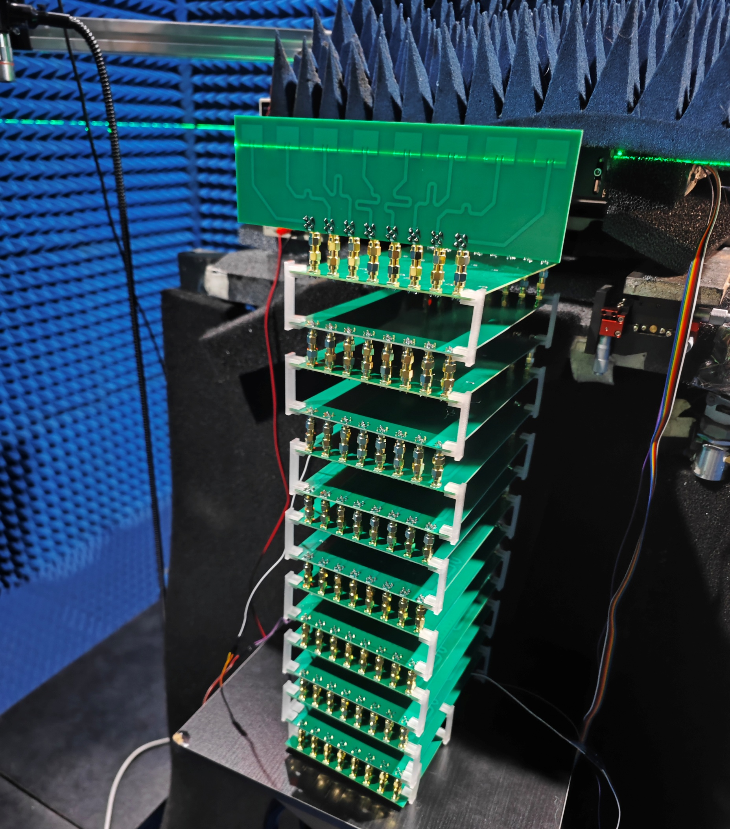


Experiment Setups
Laptop
Rx Antenna
Tx Antenna
USRP
2974
WDNN
Amplitude Modulation (AM)
Communication:
AM Decoding with WDNN
ADC
board
Laptop
Power
supply
Power
supply
5GHz
Antenna
Tx Antenna
Power
supply
$$Az$$
ADC board
$$El$$
Behind
RF Sensing:
AoA Estimation with WDNN
1x8
phased
array
RX
antenna
array
Bias and
Activation
modules
Propagation
modules
WDNN
Feature
output layer
Notes:
This is our experimental setup. During testing, we sent task-specific data to the WDNN system using either a signal generator or a USRP.
After the analog signal processing and propagation through the WDNN, the output was measured with a power detector and compared to the target labels.
这是我们的实验搭建。实验过程中，我们将不同任务的数据通过信号发生器或USRP发送至WDNN系统。
信号经过模拟传播和WDNN的处理后，由输出端的功率探测器读取结果，并与目标标签进行比对。
这三个任务涵盖了从通信信号识别到无线感知的不同应用层面，能够较为全面地展示WDNN的通用性和适应性。

Slide 21
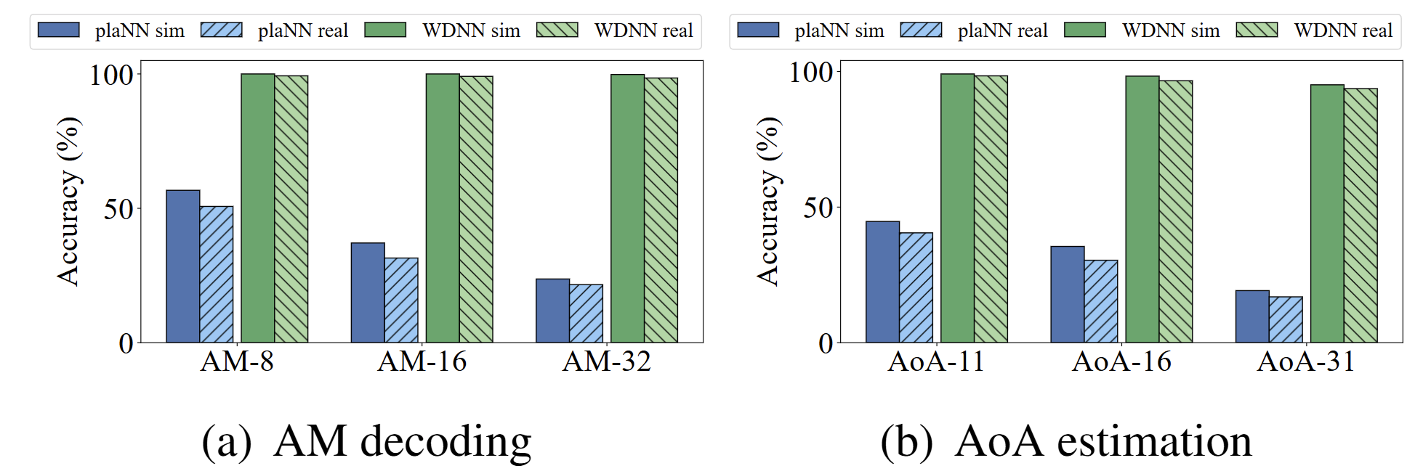

Performance
AM Decoding Performance
AoA Estimation Performance
Confusion Matrices:
32-level AM Decoding Performance
Confusion Matrices:
AoA (31-class) Estimation Performance
Notes:
First, for AM decoding, we used 32-level signals and asked WDNN to directly classify them in the RF domain—no digital demodulation needed. WDNN got 98.5% accuracy, while the traditional diffractive network only reached 21.6%.
Next, for angle of arrival, we tested signals from 31 angles using a multi-antenna array. WDNN identified the direction with 93.7% accuracy versus just 16.9% using the standard diffractive network.
首先来看AM信号解码的表现。
我们生成了32级幅度调制信号（AM-32）作为输入，任务目标是让WDNN在射频域直接识别每个符号类别，无需数字解调。
实验结果显示，WDNN的分类准确率达到 98.5%，而最新的平面衍射神经网络（plane neural network）仅为 21.6%。
这一结果非常关键——不仅证明WDNN能够“穿透电磁波”进行信号识别，还能直接完成调制与解码。
这意味着在未来的通信系统中，WDNN有望在信号尚未数字化之前提前完成部分神经计算，大幅降低系统处理延迟。
第二项实验是入射角检测（Angle of Arrival Estimation）。
我们采用多天线阵列，从-60°到+60°，共31个入射角度信号作为输入。
目标是让WDNN仅根据接收到的射频信号，准确判断信号的入射方向。
实验结果显示，WDNN的分类准确率高达 93.7%，而对比的平面衍射神经网络仅为 16.9%。
这说明WDNN能够有效捕获射频信号中的微弱相位和幅度变化，并将其准确映射为空间角度信息。
这种空间感知能力，使WDNN非常适合定位、姿态识别和射频感知等应用场景。
第三项实验是Wi-Fi跌倒检测。
我们采集了人在房间内的多种动作信号，包括站立、行走、跌倒等。
所有信号经Wi-Fi CSI采样后，实时送入WDNN硬件进行分类。
结果显示，WDNN的分类准确率达到 90.8%，比现有最前沿的射频感知方法高出 27.5%。
这表明WDNN不仅能处理通信信号，也具备杰出的动态感知能力，特别是在复杂室内多径环境下展现出卓越的鲁棒性。

Slide 22


Performance
Ablation study results showing performance
variation with the proposed propagation modules and
nonlinear activation modules.
Performance comparison with the baseline
diffractive NNs and digital deep learning methods.
Notes:
The third experiment was Wi-Fi fall detection. We used an open-source dataset of human movements, sampled with Wi-Fi CSI, and ran them through WDNN for real-time classification. WDNN reached 90.8% accuracy—27.5% higher than the best current RF sensing methods.
Across all three tasks, WDNN outperformed other neural network architectures and came very close to the performance of digital networks.
第三个实验是Wi-Fi跌倒检测。
我们使用了开源数据集中人类在房间内的动作信号。所有信号都通过Wi-Fi CSI采样，再经由WDNN硬件进行实时分类。
结果显示，WDNN的分类准确率达到90.8%，比现有最先进的射频感知方法高出27.5%。
同时我们对所有的三个实验对比了不同结构神经网络的实现，结果发现我们的WDNN远高出其他实现，同时接近数字神经网络的效果

Slide 23
© MobiCom 2025
Hong Kong, China
WDNN: Weighted Diffractive Neural Network for Physical-layer RF Signal Processing
Thanks for Listening!
Any questions: yezhouwang@sjtu.edu.cn
Notes:
That wraps up my presentation. Thank you all for listening! I’m happy to answer any questions.
我的报告到此结束，非常感谢大家的聆听。如果各位对实现细节或实验系统感兴趣，非常欢迎会后与我交流讨论。
谢谢大家！

