Slide 1

Bridge: Enabling BLE Direction Finding Feature Compatible with All Bluetooth Devices
Runting Zhang, Yijie Li, Dian Ding, Yi-Chao Chen, Yida Wang, Dongyao Chen, Jingxian Wang, Jiadi Yu, Ling Ma, Guangtao Xue
MobiCom 2025
Notes:
“Good afternoon everyone. Today, my talk is titled Bridge: Enabling BLE Direction Finding Feature Compatible with All Bluetooth Devices.
This is a joint work with my co-authors and supervised by professor Yi-Chao Chen.
Transition: “Let me start with the background and the core limitation in today’s BLE direction finding.”

Slide 2


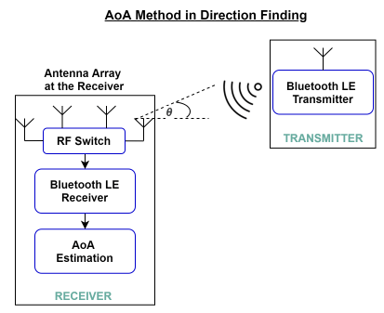
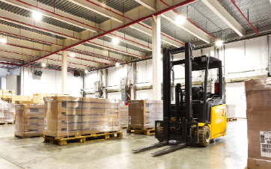


BLE Direction Finding Feature
BLE 5.1
Tag
AoA Method in Direction Finding
Asset Tracking
BLE 5.1
Tag
Official standard for BLE localization
Popular Angular-based method
High Accuracy: Decimeter-level
Indoor Navigation
Autonomous Guided Vehicles
Notes:
“BLE 5.1 introduced direction finding that is now widely used in asset tracking, logistics, and smart factories for applications including indoor navigation, autonomous guided vehicles.
The commonly used Angle-of-Arrival (AoA) method uses switched-antenna arrays to measure phase differences across elements. In controlled environments, it delivers a decimeter-level accuracy and has now become an official and popular angular-based method for BLE indoor localization.”
Transition: “However, a crucial roadblock prevents its working with the majority of existing legacy devices.”

Slide 3




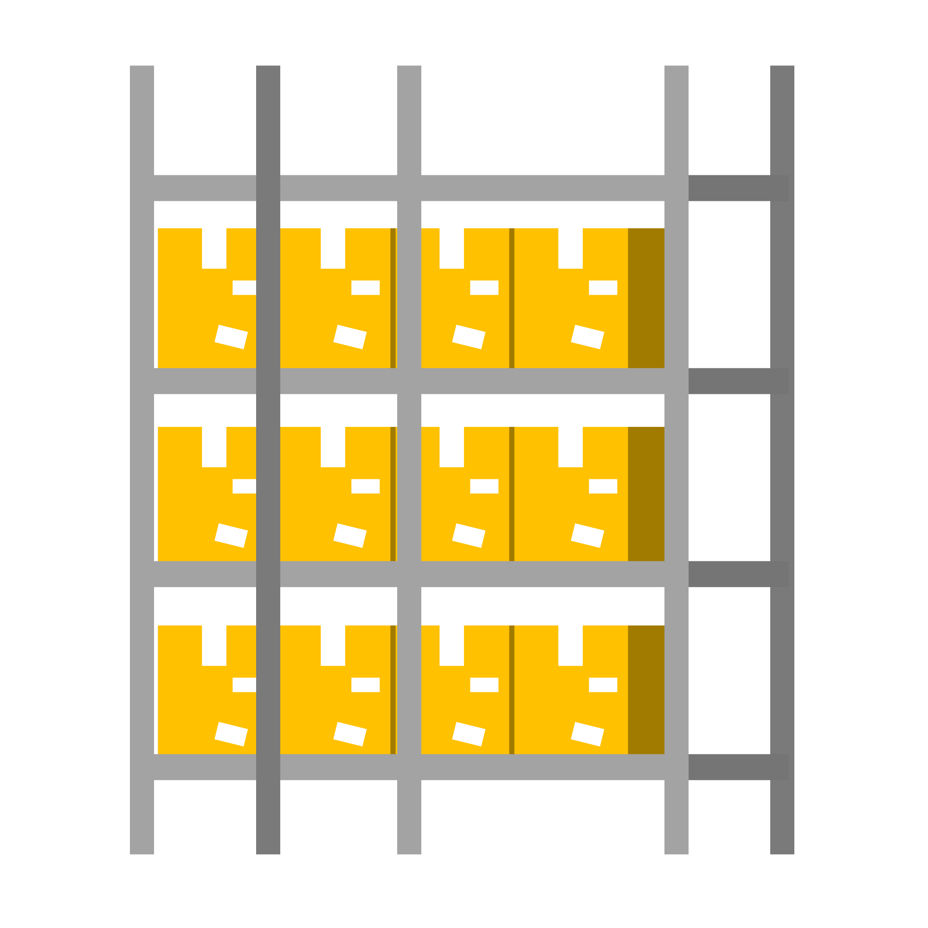
Problem: Backward Compatibility
BLE 5.1 Locator
GOT YOU！
AoA
BLE Direction Finding works well on BLE 5.1+ Tags.
Still over 4.1 billion (68%) BLE devices version is below BLE v5.1.
No backward compatibility in standard Direction Finding system. - Even higher BLE version device may not support direction finding.
Only Data
Transmission
Localization
BLE 5.1
Tag
BLE 5.2
Phone
BLE 4.1
Tag
Standard BLE 5.1 locator CANNOT get AoA of other BLE devices
Notes:
“Currently, the official BLE 5.1 locator works well on BLE 5.1+ tags, but it cannot obtain AoA from devices that do not explicitly support the direction finding feature.
In fact, more than half of deployed BLE devices still run versions below 5.1, and even some newer stacks may ship without DF support enabled. The result is no backward compatibility: AoA works great on BLE-5.1 tags, but not on ordinary legacy devices.”
Transition: “This motivates our work.”

Slide 4
Motivation
BLE 5.1 Locator
GOT YOU！
AoA
We want to:
Localize old BLEs without modifying hardware or firmware of either locator or target.
We have to:
Follow standard protocol design.
To do that, we first dive into the direction finding protocol.
Only Data
Transmission
Localization
BLE 5.1
Tag
BLE 5.2
Phone
BLE 4.1
Tag
Standard BLE 5.1 locator CANNOT get AoA of other BLE devices
Notes:
“We asked: can we leverage existing, standards-compliant locators to localize unmodified legacy targets?
Our requirements are strict: we have to stay within the standard protocol design and avoid any hardware or firmware changes on both locators and targets.”
Transition: “To answer this, we first revisited how the DF protocol actually works.”

Slide 5


BLE Direction Finding Protocol
Locator
Advertising
Ext Adv
Periodic advertising
……
Constant Tone Extension (CTE)
① New payload format: CTE info
② New CTE structure: Fixed Frequency
…
AUX_SYNC_IND
AUX_SYNC_IND
ADV_EXT_IND
AUX_ADV_IND
CTE Info
CTE
CTE Info
CTE
Target
Advertising
Channel
Data Channel
Direction Finding Request (CTE request)
CTE Format: 1$μs$ switching and sampling slots
Guard Period
（4$μs$）
Reference Period
（8$μs$）
PDU Type undefined
BLE 5.1 Locator
Switch
slot
Sample
Slot 1
Switch
slot
Sample
Slot 2
…
Switch
slot
Sample
Slot 74
AoA
No CTE detected
Data Transmission
BLE 4.1
Tag
Notes:
“Direction finding utilizes the newly proposed periodic advertising process and hinges on the Constant Tone Extension, or CTE segment. It introduces a new payload format and a fixed-frequency tail that the locator samples with a known antenna-switching pattern. To compute AoA, the locator must receive a legal packet (here, AUX_SYNC_IND) containing a known CTE at the expected time and on the correct BLE channel.”
So, here is the case when directly putting lower version BLEs into direction finding: when the BLE 5.1 locator tries to start the direction finding by making a CTE request, the legacy target decodes but fail to recognize the undefined PDU type. Though data transmission in between is allowed following older protocols, localization process won’t work since no CTE segments are transmitted and received by locators.
Transition: “So if we want legacy devices to be localized, we must make them—without modifying them—appear to the locator as sending a valid, known CTE at the right time and channel.”

Slide 6
Goal and Requirement
Goal
Requirement
Utilize existing Direction Finding system to localize old BLE device (target) without hardware modifications:
Control target to send “known signal” on certain time and BLE channel.
Make locator receive “expected signal” on legal time and channel following direction finding protocol.
Sync target and locator in the same BLE channel (signal frequency).
Sync target and locator in communication time interval.
Make target send legal BLE packet with known signal.
Ensure locator receive legal signal within CTE period for localization.
Notes:
“That is, to achieve our goal, we must control target to send some kind of “known signal” on certain time and BLE channel, and meanwhile make locator receive “expected signal” on legal time and channel following DF protocol.
Concretely, we need to:
(1) synchronize the target and locator on the same BLE channel (which means the same signal frequency);
(2) synchronize their communication time;
(3) and also ensure that the target transmits a legal BLE packet carrying a known signal; and
(4) ensure the locator will receive that known signal within the CTE window so it can perform the following localization process.”
Transition: “This leads to the high-level design of Bridge.”

Slide 7

Bridge in High Level
BLE 5.1 Locator
GOT YOU！
High-level idea: add a Trigger to synchronize the communication.
Trigger talks to target in old BLE protocol (Data transmission)
Trigger talks to locator under BLE direction finding protocol
Time and Channel synchronized
Locator overhear between Trigger and Target, and consider exchanged packet as CTE for localization.
AoA
Overhearing
Data
Transmission
BLE 5.2
Phone
BLE 4.1
Tag
Trigger
BRIDGE can bring direction
finding to ALL BLE devices
Notes:
**“Bridge inserts a new component called the Trigger.
To the target (usually a legacy BLE device), the Trigger talks using the old, ordinary BLE protocol.
And to the locator, the Trigger behaves according to the official direction-finding process.
By carefully synchronizing time and channel, the locator overhears the packets exchanged between Trigger and target and will finally treat the appropriate portion as a CTE for localization—without any modifications to either endpoint.”**
“Intuitively, the Trigger ‘bridges’ two worlds: it speaks legacy BLE to the target and ‘speaks DF’ to the locator, aligning them so the locator can compute AoA from an overheard, standard-looking CTE.”
Transition: “To make this robust, we build a full pipeline from packet orchestration to AoA estimation.”

Slide 8

Packet Flow
Command
Signal
Target
Nesting Packet
Packet
stream
Localization Server
Trigger
Overhearing
IQ Samples and
Packet Stream
IQ Samples
Locator
AoA Estimation via Overhearing
Arrival
Time
Arrival time Estimation
Reference Cancellation
Virtually
Aligned Phase
CFO Estimation
Switched Antenna Array Alignment
Phase w/o
CFO error
AoA
AoA Algorithm
Weighted Phase
Interference Mitigation
Notes:
Here you can see, when a DF is commanded from the server, our trigger behaves through a special packet-flow design, including a special nesting packet mechanism (which will be talking later) to achieve a successful overhearing on locators. Once the sampling IQs are generated from locators, we further apply a series of processes and algorithms to get our robust AoA output through the overhearing signal, as well as the final positioning result.
Transition: “With that overview, let me unpack three technical challenges and our solutions.”

Slide 9
Challenges
Synchronizing Target and Locator under Direction Finding Process without modification on Target.
Accurate AoA Estimation in Overhearing.
Scalability in Large-scale Deployment.
Notes:
To sum up, we face the challenges of:
How to synchronize the target and locator without any modifications?
How to achieve an accurate AoA estimation via the overhearing signal?
And lastly, dealing with some scalability issues when making a large-scale deployment.

Slide 10
Challenge 1: Synchronizing Target & Locator
Standard BLE Connection Establishment
Target
ADV_IND
S→M
Packet Collision
CONNECT_REQ
Trigger
M→S
ADV_EXT_IND
AUX_ADV_IND
AUX_SYNC_IND
w/o standard CTE
Locator
Received CTE Info
Antenna Samples
Standard Direction Finding Process
(Periodic Advertising Mode)
Notes:
“The first challenge is to synchronize the unmodified target and the locator’s DF process in both time and channel. Since DF strictly limits the CTE transmission in BLE data channels, we therefore focus on the BLE Connection Establishment and data transmission on older version BLE protocols. When adding this onto the standard DF process, and we manage to synchronize the timing interval, we found an inevitable packet collision on Trigger between the M-S to Target, and the AUX_SYNC_IND to locator, after carefully comparing the timing offsets based on their protocols.
Transition: “Our key idea is a nesting-packet design.”

Slide 11
Key Idea: Nesting Packet Design
M → S
Pr
AA
Header
Payload
CRC
Original
AUX_SYNC_IND
Insert into
Pr
AA
Header
EH Length
Adv
Mode
EH
CTE Info
Adv
Data
CRC
CTE
Same
Analog Signal
for Locator
Same
Payload
Same
Analog Signal
for Target
RF Interface
Same Payload
Pr
AA
Header
EH Length
Adv
Mode
EH
CTE Info
Adv
Data
M → S *
CRC*
CTE
Nesting
AUX_SYNC_IND
Append Content
Notes:
Just look at the packet structure of these two packets. We aim to somehow insert the whole M->S packet into the original AUX_SYNC_IND to create a new, nesting AUX_SYNC_IND packet. We choose the Adv Data segments, which avoid impacting on the essential payload parts for a successful CTE transmission. Specifically, we keep the preceding part of AUX_SYNC_IND to be exactly the same, while designing a new M-S* that, after encoding and modulating differently by Trigger, maintains the same analog signal in RF interface to ensure that the target will decode the same payload just as the original M-S.
Instead of giving more detailed process and algorithms, I’ll show how our synchronization via nesting packet actually works.

Slide 12
Synchronization via Nesting Packet
T₁ > 80 us
T₂ > 80 us
Target
T_{IFS} = 150±2 us
S → M
Temporal Overlap
Trigger
M → S
AUX_SYNC_IND
w/o standard CTE
1
Locator
Received CTE Info
Antenna Switching
and Sampling
T₃ > 160 us
T₄ = 160 us
Notes:
When originally the Trigger tries to separately send these two packets, the inevitable temporal overlap occurs and hinders its transmission.
And after we applying the nesting packet scheme,

Slide 13
Synchronization via Nesting Packet
T₁ > 80 us
T₂ > 80 us
Target
T_{IFS} = 150±2 us
S → M
M → S
same analog signal
Insufficient Sampling
Trigger
Pr
…
Adv
Data
M → S*
w/o standard CTE
AUX_SYNC_IND
2
Locator
Received CTE Info
Antenna Switching
and Sampling
T₃ > 240 us
T₄ = 160 us
Notes:
The locator receives the required CTE Info and expects a CTE reception to perform corresponding antenna switching and sampling. Target, on the other hand, demodulate and decode the M-S* segments just as receiving an original M-S packet, and will be sending a response S-M. But still, the sampling length within the CTE period is insufficient, leading to a rising AoA estimation error.

Slide 14
Synchronization via Nesting Packet
T₁ > 80 us
T₂ > 80 us
Target
T_{IFS} = 150±2 us
S → M
M → S
same analog signal
Trigger
Pr
…
Adv
Data
M → S*
w/o standard CTE
AUX_SYNC_IND
Append
Content
Overhearing
Locator
Received CTE Info
Antenna Switching
and Sampling
T₄ = 160 us
Notes:
As a result, we make temporal adjustment by appending contents after M-S* segments, as our complete synchronization design, to carefully control the incoming of S-M signal during CTE period, providing an optimal signal overhearing performance.
Now the question goes to: how to estimate AoA via overhearing signals?

Slide 15

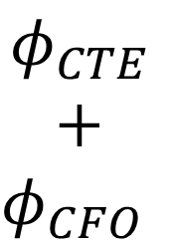



Challenge 2: AoA Estimation via Overhearing
Reference Period(8μs)
Switch
Slot
Smpl
Slot 1
Switch
Slot
Smpl
Slot 2
Switch
Slot
Smpl
Slot 3
…
Switch
Slot
Smpl
Slot 74
Standard CTE (All 1s)
$$φ_{CTE}$$
$$+$$
$$φ_{CFO}$$
$$φ_{1→3}+{2φ}_{CFO}$$
Phase
$$φ_{1→2}$$
$$+$$
$$2φ_{CFO}$$
……
$${2φ}_{CTE}$$
$${2φ}_{CTE}$$
Time
Real Antenna
Virtual Antenna
Notes:
All right, the AoA estimation in overhearing has some similarity to the standard DF, but still greatly differs from processing standard CTEs. Now first take a look at what happens to the standard CTE samplings. The reference period samples (red circles), since they are from the same antenna element, are used to calculate the phase difference $φ_{CTE}$ (constant due to the fixed frequency) $φ_{CFO}$ (carrier frequency offset). And after antenna switching, a virtual antenna (orange dashed circles) is aligned to derive the $φ_{1→2}$ … , critical parts for following angular algorithms to output AoA.
But now, instead of sampling the standard CTE

Slide 16


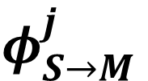

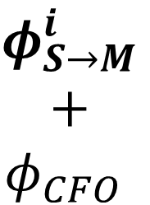
AoA Estimation via Overhearing
Reference Period(8μs)
Switch
Slot
Smpl
Slot 1
Switch
Slot
Smpl
Slot 2
Switch
Slot
Smpl
Slot 3
…
Switch
Slot
Smpl
Slot 74
S → M Overhearing
Phase
$$φ_{1→3}$$
$$+$$
$$2φ_{CFO}$$
$$φ_{1→2}$$
$$+$$
$$2φ_{CFO}$$
$$φ_{S→M}^{i}$$
$$+$$
$$φ_{CFO}$$
Uncertain
Arrival
Time
$$φ_{S→M}^{k}$$
$$φ_{S→M}^{j}$$
Time
Effective Part
Notes:
But now, instead of sampling the standard CTE, we generate samples during overhearing. As you can see, it raises several problems including an uncertain arrival time (leading to an uncertain effective part within the whole CTE samplings), a different phase offset $φ_{S→M}^{i}$ (not constant, but relies on the distinct S-M signal), and other corresponding changes and influences before deriving $φ_{1→2}$.
We address this with three steps:
Reference cancellation including an accurate arrival time estimation to remove phase offsets;
2-stage CFO estimation—coarse and fine-grained; and
AoA computation with interference mitigation.”**
Due to time limits, I’ll skip all details, and
Transition: “Next, we must make the system scale.”

Slide 17
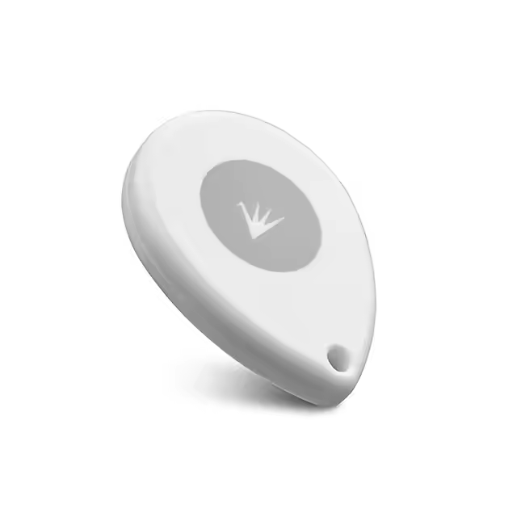
Challenge 3: Large-scale Deployment
Concurrent Targets
Concurrent targets may exceed the Trigger’s capacity.
Dynamic Packet Flow Switching
Notes:
“For the third challenge of the large-scale deployment, we mainly focus on two common but essential problems that may occur.
First, in practice, multiple concurrent targets can exceed a single Trigger’s capacity, causing extremely low update rate for some targets or even their localization failures.
“As for our solution, we apply a Dynamic Packet-Flow Switching method,

Slide 18


Target
Trigger
Locator
ADV_IND
ADV_EXT_IND
CONNECT_REQ
Only a few concurrent targets:
Keep connections
Higher AoA update rate
AUX_ADV_IND
$$N_{c}<N_{th}$$
AUX_SYN
C_IND
CTE Info
M → S*
One AoA estimation
S → M
Antenna
Sampl
Large number of concurrent targets:
Establish new connections
Round-robin
Stable with lower AoA update rate
ADV_EXT_IND
Update
Interval
ADV_IND
Update
Interval
$$N_{c}≥N_{th}$$
ADV_EXT_IND
AUX_ADV_IND
CONNECT_REQ
AUX_ADV_IND
AUX_SYN
C_IND
CTE Info
M → S*
AUX_SYN
C_IND
CTE Info
M → S*
S → M
Antenna
Sampl
S → M
Antenna
Sampl
Notes:
The high-level idea is to choose different connection establishment mode for data transmission between Trigger and targets.
At a low concurrency, Trigger keeps all established connections for a higher AoA update rate.
But when facing a large number of concurrent targets, it switches to establish new connections through round-robin to maintain the system stability.

Slide 19

Challenge 3: Large-scale Deployment
Concurrent Targets
Handover
Near
Far
Concurrent targets may exceed the Trigger’s capacity.
Nearby locators fail to operate due to Trigger Handover.
Dynamic Packet Flow Switching
Uniform Trigger Operation Pattern
Notes:
“Also, the Trigger handover can disrupt nearby locators while activating those far-away locators, hurting the AoA and localization accuracy.
Here, we introduce a Uniform Trigger Operation Pattern across triggers.

Slide 20
Trigger Handover
Different MAC address and connection parameters in CONNECT_REQ.
Apply a uniform operation pattern for All Triggers.
Notes:
Instead of using different parameters when establishing connections, we apply a Uniform Operation Pattern across triggers: by aligning their behavior…

Slide 21
Trigger Handover
Apply a uniform operation pattern for All Triggers.
Same parameters for All Triggers.
All nearby locators are activated and operating localization process.
Notes:
by aligning their behavior, nearby locators remain activated and continue the localization process even during handovers. This removes the ‘stall’ that would otherwise happen when a locator expects a CTE but the Trigger roles change.”
Transition: “Having addressed challenges of synchronization, AoA estimation, and scalability, let me show our prototype and results.”

Slide 22
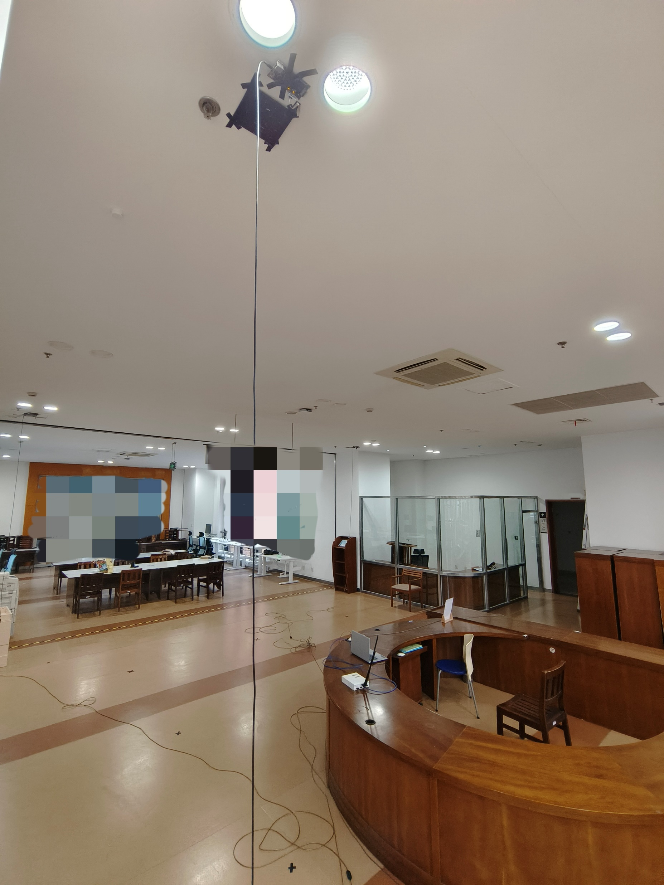
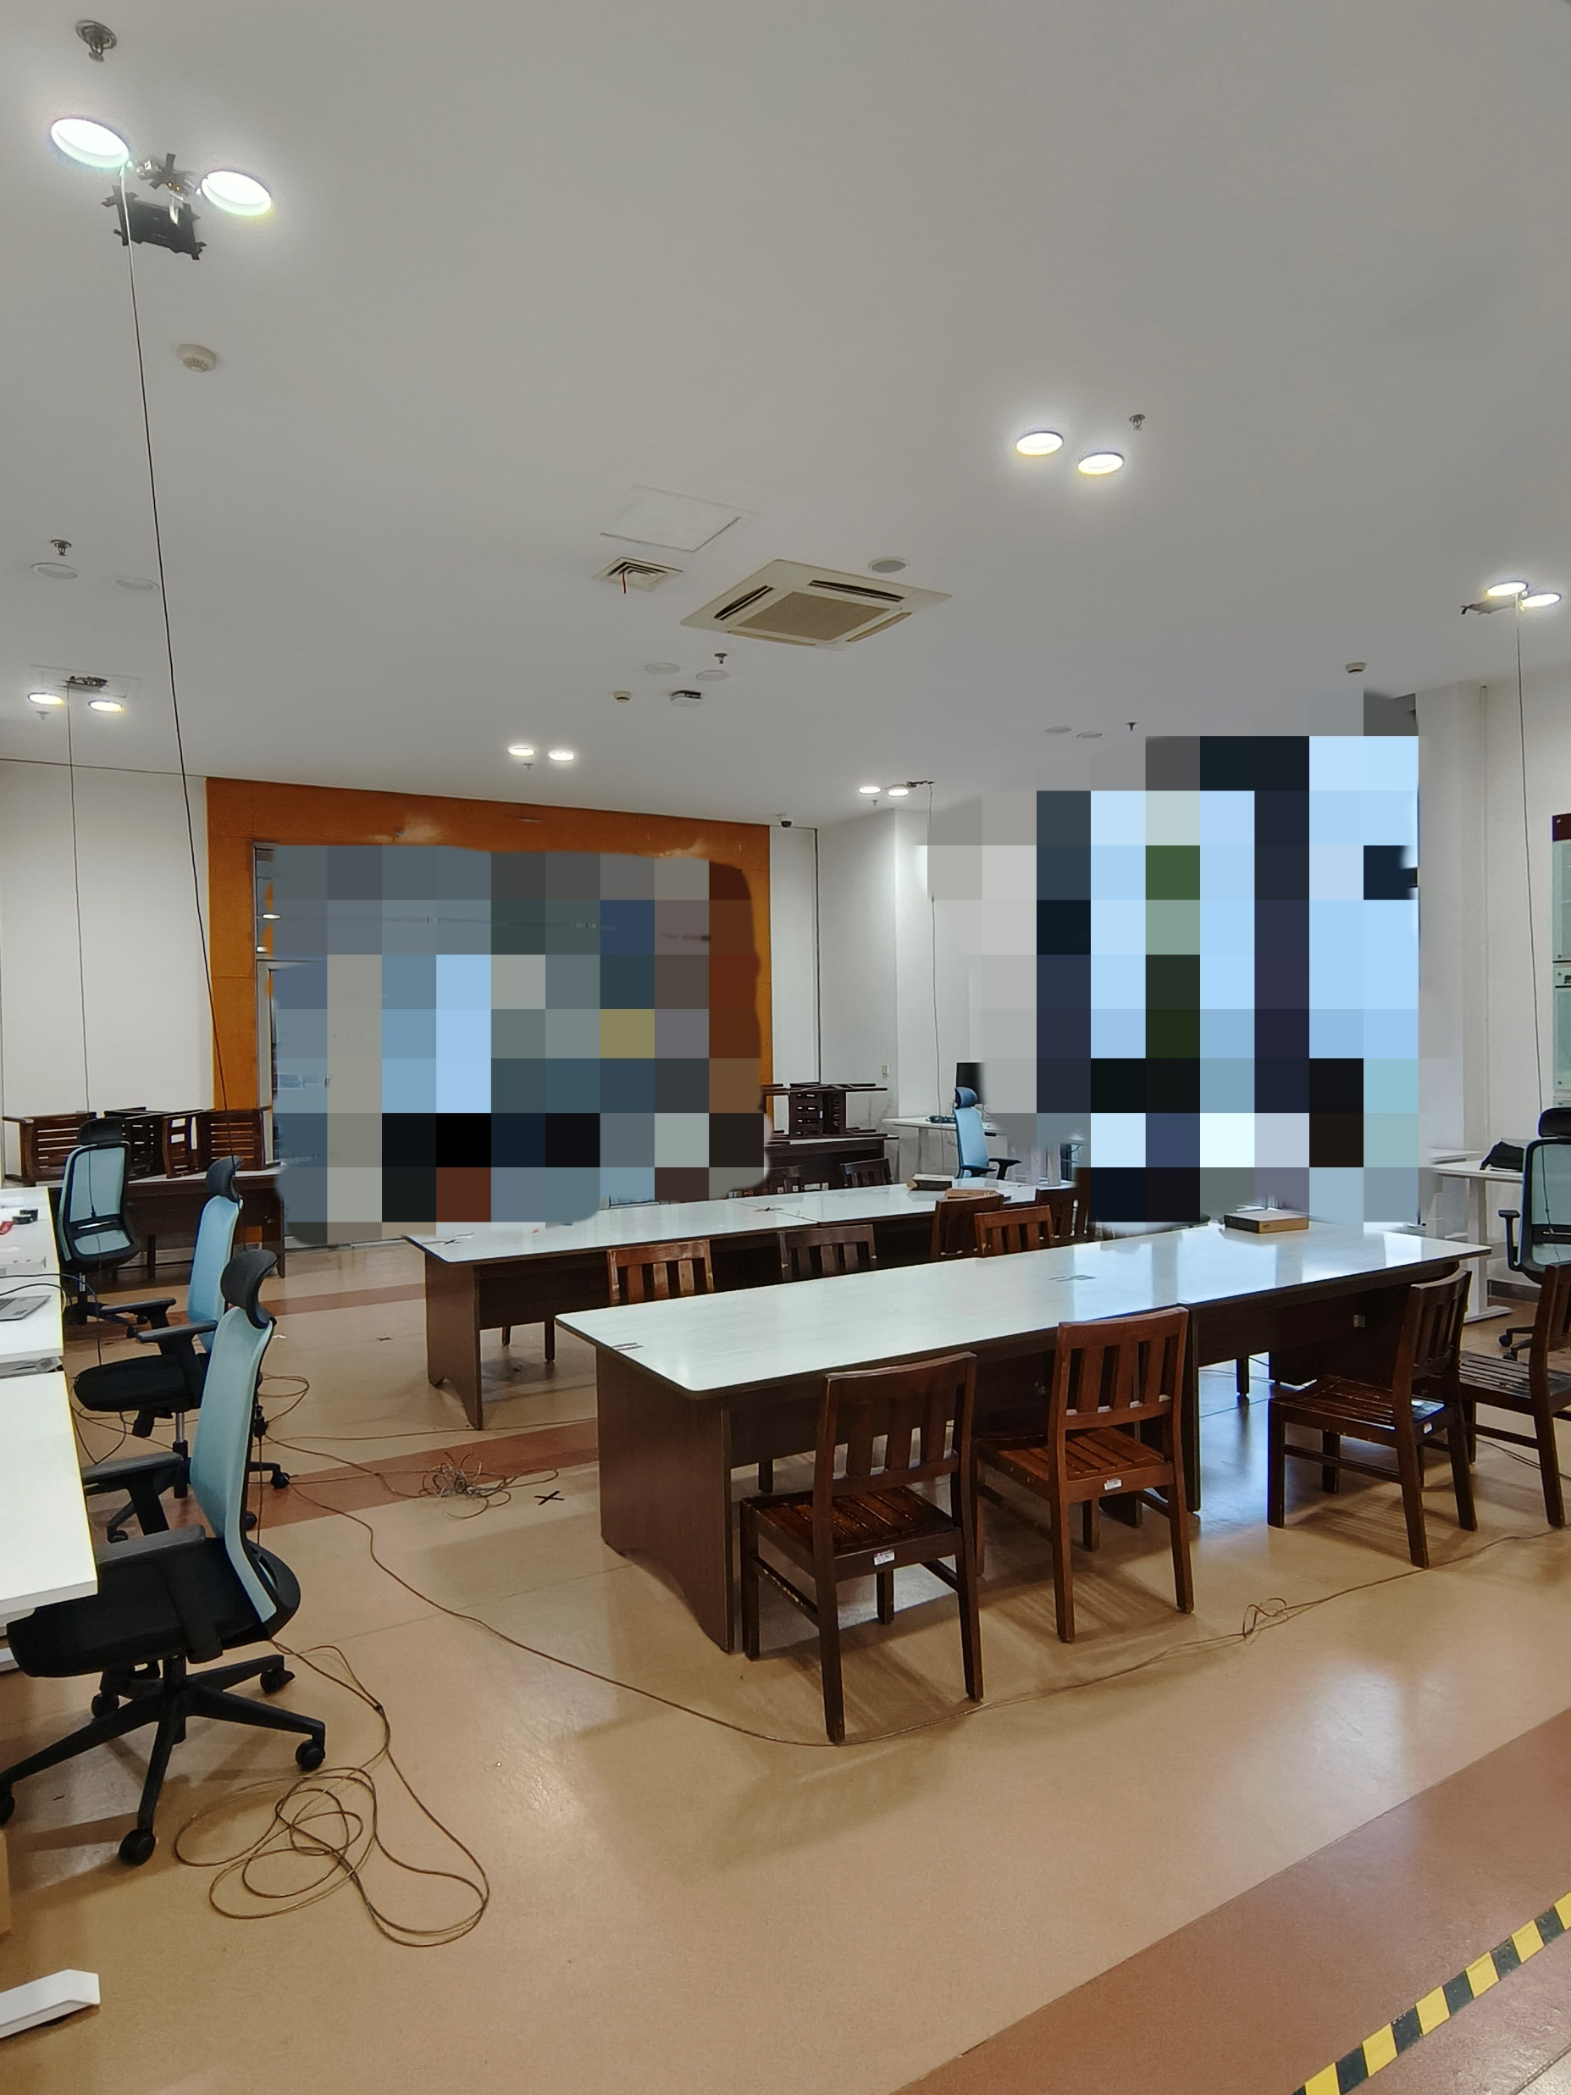
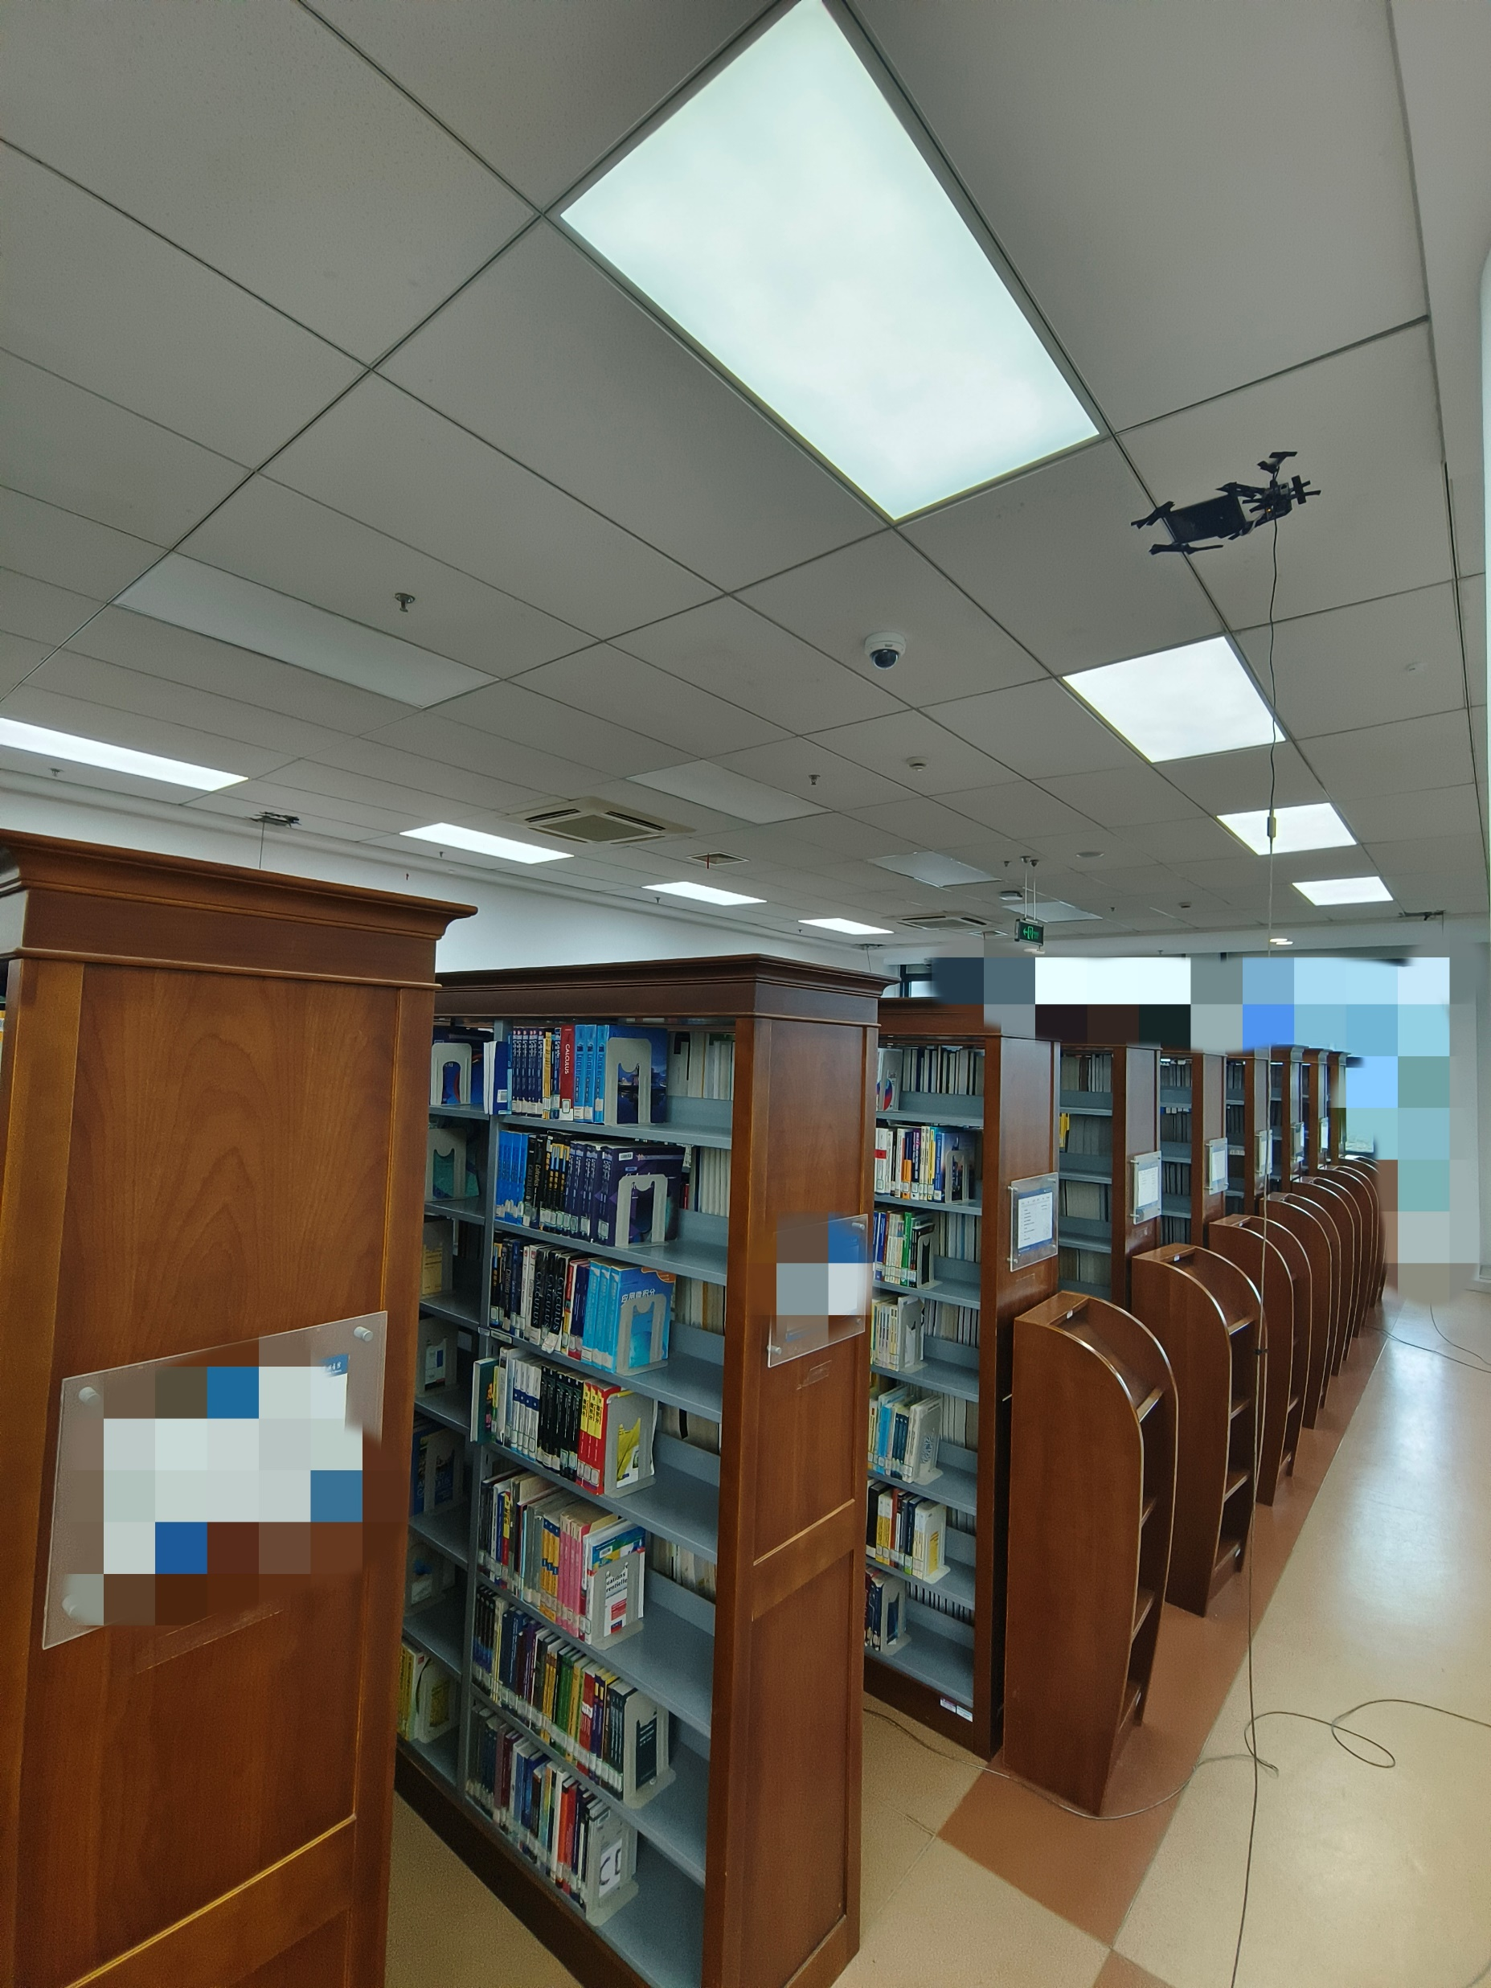
Experiment Setup
Locators
Trigger
Opening Space
Tables and Chairs
Crowded Bookshelves
Notes:
“We built a working prototype with standard BLE locators, our Trigger implementation, and off-the-shelf legacy BLE targets. We evaluate in realistic indoor deployments (inside a school library) under multiple environments with various levels of obstacles and interference.”
Transition: “Now to the performance.”

Slide 23
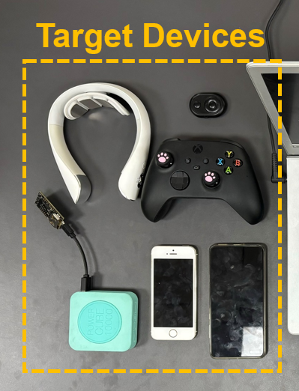
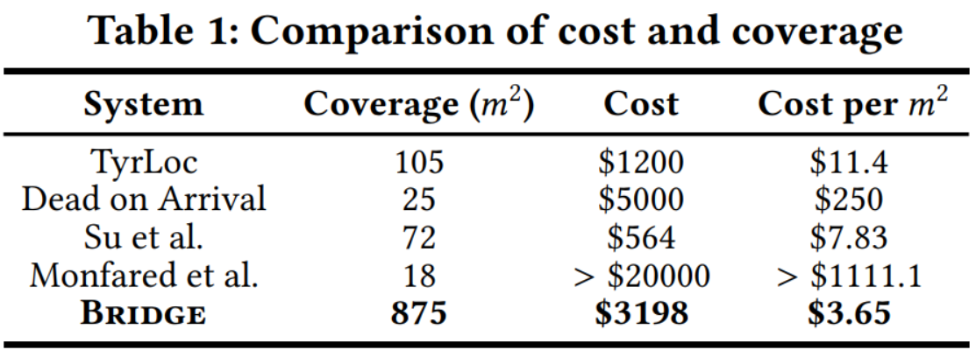
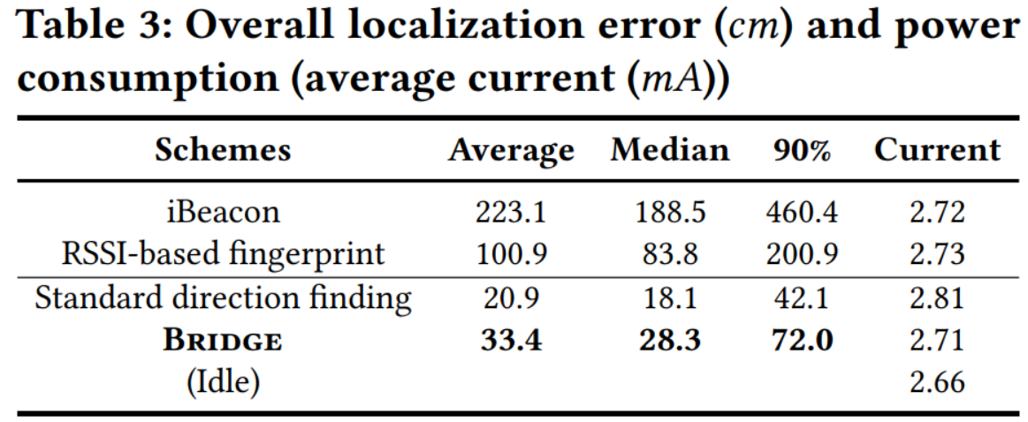
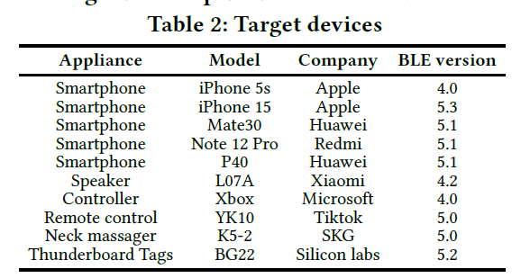
Performance
Covering more area with less cost per square meters
Close performance to standard Direction Finding
Notes:
“Under the test of different BLE devices with various BLE versions (and they are all originally unsupported by standard DF,) Bridge achieves close performance to official DF while extending compatibility to legacy targets. Because we can reuse existing locators and avoid specialized tags, we can cover more area at lower cost per square meter. This is particularly attractive for large-footprint deployments where replacing end devices is infeasible.”
Transition: “I’ll wrap up with the takeaways.”

Slide 24
Conclusion
Proposed Bridge that makes BLE official Direction Finding compatible with every BLE device without modifications.
Designed a Nesting Packet scheme for Trigger to mimic communication behaviors with both Locators and Targets.
  - For other system details, including CFO Estimation, Interference Mitigation, and Scalability, please check our paper for more information.
Notes:
**“To conclude:
We propose Bridge, which makes official BLE direction finding compatible with every BLE device—without modifying locators or targets.
Our designed nesting-packet scheme for Trigger, synchronizes legacy targets with DF locators in both time and channel, successfully mimics their individual communication behaviors.
And for other system details, please check our paper for more information.
“Thank you for your attention. I’m happy to take questions.”

Slide 25
Thank You
Notes:
Thank you!

Slide 26
Following
are backups
Notes:
Switched-Antenna Array Alignment：我们遵循官方切换序列；误差通过参考期校正与阵列标定吸收。
CFO 细节：先做稳健线性回归得到粗估，再在有效参考期内细化；结合相位展开避免环绕。
干扰抑制：对抗附近并发BLE流量的带外/带内干扰，结合参考抵消与包级选择策略。
触发器切换：统一的触发器操作模式使得邻近定位器在切换期间保持“被激活”状态，避免定位流程重置。
合规性：全流程遵循BLE标准字段与时序，不改动目标或定位器固件/硬件。

Slide 27
Switched Antenna Array Alignment
Dynamic Threshold
IQ samples from locator
Adjacent Sample
Outliers
Phase Differential
Preliminary Scope
Phase sampled at the same antenna
Notes:
通过到达时间估计、参考信号消除 实现天线阵列切换过程采样的相位对齐

Slide 28

Switched Antenna Array Alignment
Ideal S → M signal
Peak
Phase Differential
$$t_{corr}$$
Phase sampled at the same antenna
$${T_{arrival}=t_{0}+t_{ideal}−t}_{corr}$$
Convolution
Phase sampled at the same antenna

Slide 29
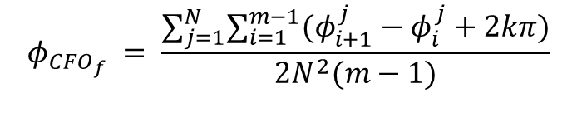





CFO Estimation
Phase (after reference cancellation)
S → M Overhearing
$$φ_{1→2}$$
$$+$$
$$2φ_{CFO}$$
$$φ_{1→3}$$
$$+$$
$$2φ_{CFO}$$
$$φ_{CFO}$$
……
Time
Effective Reference period
Coarse-grained
Robust linear regression
$$φ_{CFO_{c}}$$
$$φ_{CFO_{f}} = \frac{∑_{j=1}^{N}∑_{i=1}^{m−1}(φ_{i+1}^{j}−φ_{i}^{j}+2kπ)}{2N^{2}(m−1)}$$
, where
Fine-grained
$$k =⌊ (2N×φ_{CFO_{c}})/(2π) ⌋$$
Notes:
针对Overhearing的特殊CFO估计

Slide 30
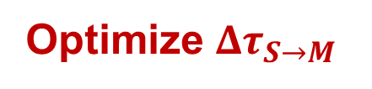


Interference Mitigation
Nesting Packet
Pr
AA
Header
EH Length
AdvMode
CTE Info
Adv
Data
CRC*
CTE
EH
M→S*
AUX_SYNC_IND
Adv
Data
M→S*
Append Content
$${Δτ}_{M→S}={Δτ}_{S→M}$$
More sampling for interfered antennas
Optimize $Δτ_{S→M}$
$$Δτ_{S→M}$$
1
2
Packet
Notes:
通过优化算法消除干扰

Slide 31

Prototype Demo
Notes:
要配音? 时间是否足够？

Slide 32
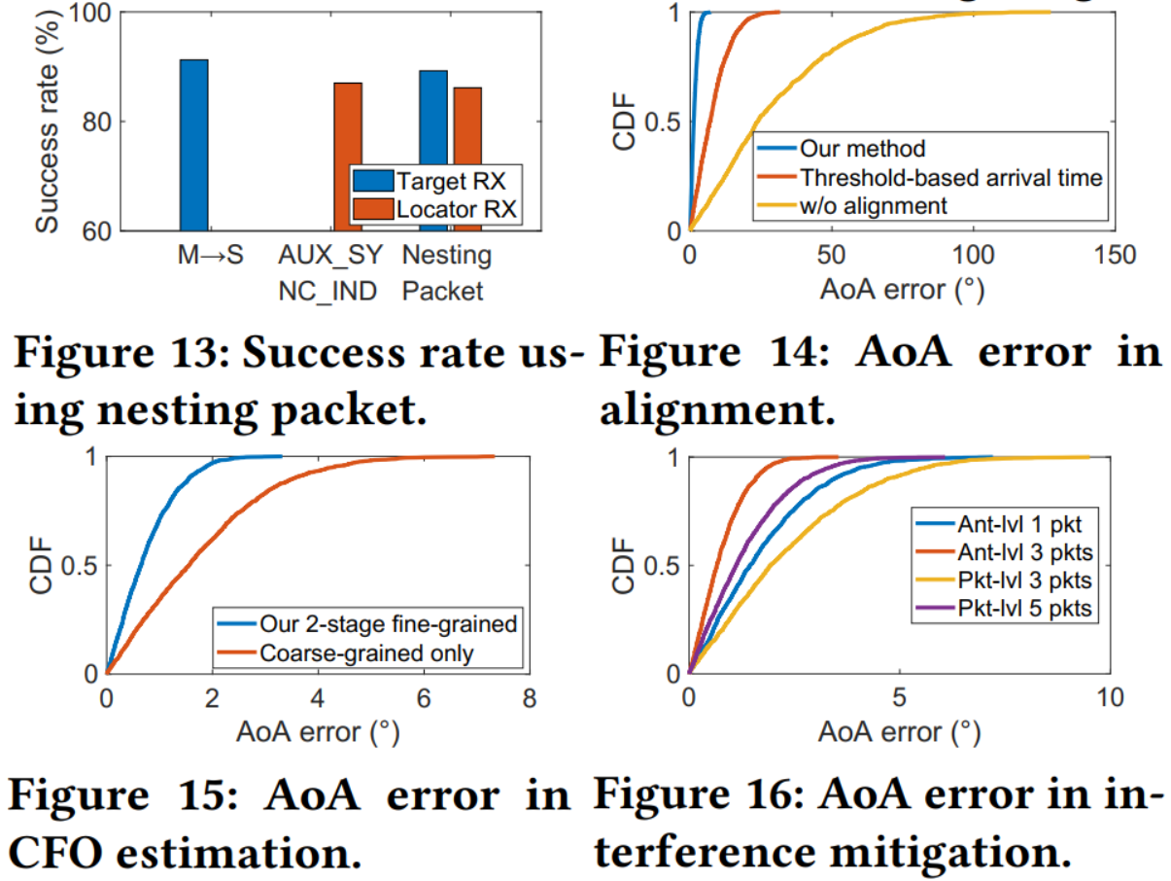
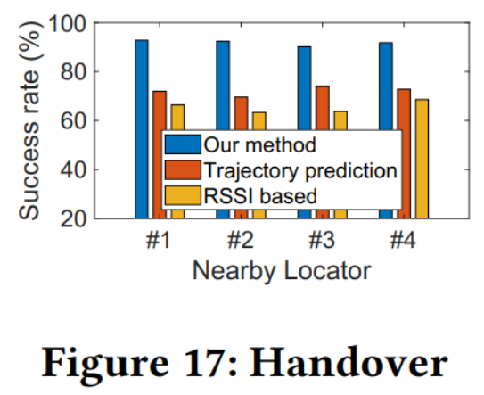
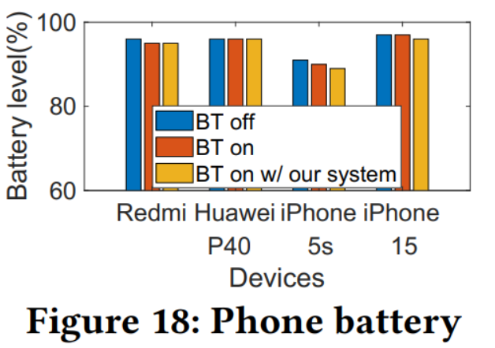
Micro-benchmarks
Notes:
备用

Slide 33
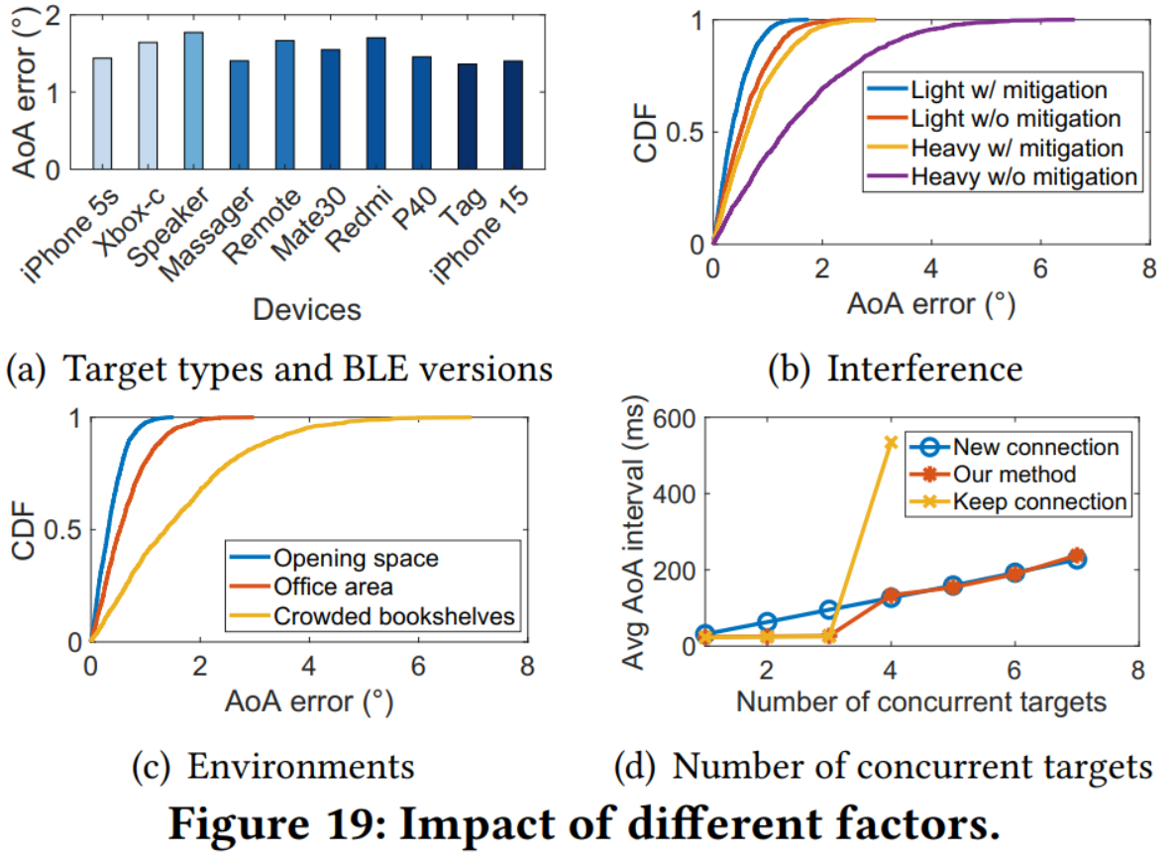
Impact of Factors
Notes:
备用

